Slide 1
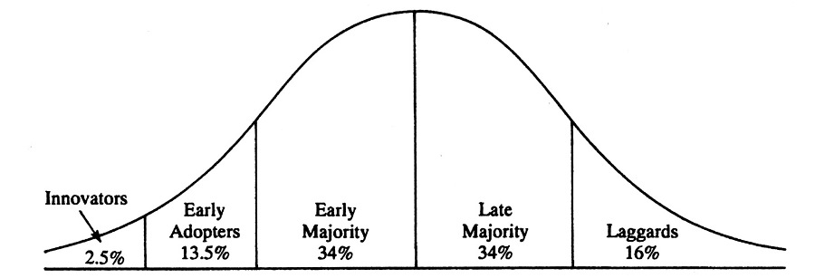
Diffusion of Innovation
Notes:
Early - Creative, less risk averse, vision
E Maj – pragmatic
L Maj - conservative
Lag – Sceptic
Key thing
start small, think big, act fast – share learning
About 16% there is a tipping point. A move from scarcity to normalising (social proof)
Need a push in communication and drive to get to the critical mass – (past the chasm)
So what we doing
NOW - Work with local teams across Scotland to support small and large scale QI work that is directly linked to the achievement of one or more of the MAT standards. Supported by DDTF
SOON- Rapid scale up of much larger packages of care of 5 or more standards in areas of high need. Supported by SG –
the expectation is that this SCALE UP will take us to and past the tipping point (and chasm) where delivering or working towards the delivery of the MAT standard becomes more normal than unusual – there is ‘social proof’ that it works. And a good portion of the ‘proof’ has to include the views of people with experience of problematic drug use
Once past the tipping point this is where the change starts to become sustainable. Where there is a change of culture. But it needs resources

Slide 2
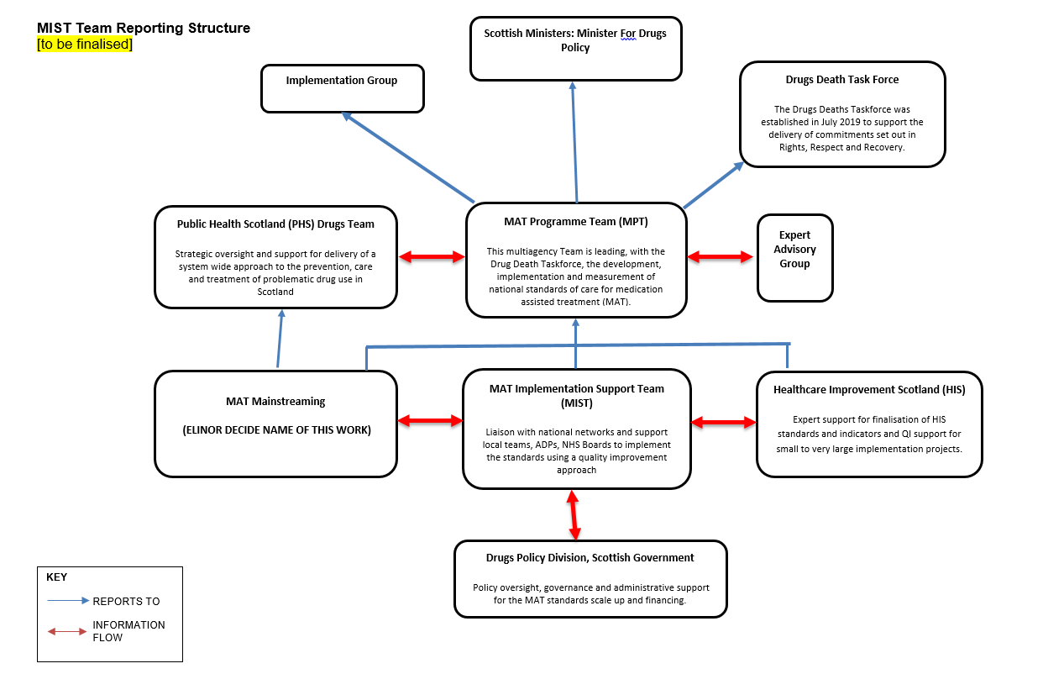

Slide 3
Questions on proposal
4 levels of work and identification of areas
Development of project specifications
Learning sharing
Progress tracking

