Slide 1
Community Link Worker Programme
Health Scotland
&
ISD LIST
Gordon Hunt
Senior Information Analyst
Themina Mohammed
Principle Information Development Manager

Slide 2
Information Services Division Mission:
“To transform information into evidence for action to protect and improve health and well-being in Scotland”
* Data included in this presentation is provisional based on the data available at the time of presenting. Due to the differences in collection methodologies and submitted data across the different sites, a number of assumptions have been made to permit illustrative comparisons of the data. Therefore, publication of this data is not recommended and any further interpretation of the figures shown should be treated with caution. It is also important to note that figures may change in future outputs
Notes:
Harness… means bringing together so its under your control to you use it, I am also now an expert at harnessing a horse

Slide 3
Data from cradle to grave
Mental Health
Continuing care census
Dental inspection
Outpatients
Hospital Admissions
Scottish birth record
Substance misuse
GP consultations
BIRTH
Immunisation
DEATH
Maternity
Prescribing
Screening
Cancer registry
A&E
Child health surveillance
Clinical audits
Most of our data sets offer 100% coverage
Community Health Index – CHI seeded
Notes:
Huge source of information – some gaps (social care, community) which are currently being addressed.
Most are 100% coverage, many good back decades so it’s a huge, powerful source of longitudinal health data about the population.
Also, within Scotland, we have the capability to link the data together, creating patient pathways to enable follow-up of specific patient cohorts.
Most of our data comes from data which is collected at source for front-line care.

Slide 4
LIST: Local Focus
Present
North
North
North Centre
Local
Local
Local
Local
West Centre
Local
Local
Local
Local
East Centre
Local
Local
Local
Local
Local
Local
ISD Specialist Teams
ISD Specialist Teams
West
East
West
East
Local
In the past
Notes:
Mention we are very data rich in Scotland with many data sets.
One of our key abilities is to link these data together
We do that using a unique CHI that is attached to each of our health records
One particular platform that we provide access to our customers too is Source
This platform routinely links health and social care data
Data collection
Activity and Costs
Health & Social Care information
Interactive Dashboards
Linked Health and Social Care data
Population Classification
Pathways
Benchmarking

Slide 5
Understanding the wider determinants of health

Slide 6
Community Link Worker: project pathway
Issues around what can be collected on current systems to support evaluation
7. Facilitate the Information Governance requirements to allow data to be sent to LIST and for analysis
Further consultation with CLWs on the draft dataset; ensuring minimal burden of additional data
2. Agree /manage expectations measurable outcomes
Use existing national coding structures where applicable
4. Discuss /align data capture
Analysis and outputs
6. Create standard coding lists for data collection
1. Review SG Evaluation Questions
3. Collate what data are currently captured by CLW
To test the draft minimum dataset.
Working with HS and CLW project team to Identifying requirements
5. Agree sign off –
minimum core dataset for CLW
CLW – Community Link Worker
HS – Health Scotland
SG – Scottish Government
Notes:
The aim of the project is to use third sector data to evidence the effectiveness of third sector interventions, looking at these as part of the overall patient pathway.

Slide 7
Minimum Core Dataset for Community Link Worker Programme
Consent to share information with NSS LIST
[Information Governance prior to data sharing]
Practice code
Unique patient programme identifier
Age
Gender
Ethnicity
SIMD /(Postcode)
Non-English speaking
Date of referral to CLW
Referral route/source
Reasons for referral
Date first seen by CLW/1st Programme participation
Reason not seen by CLW
Repeat contacts/follow-up appointments
Onward referral – resource type
Availability of services/gaps in local service provision

Slide 8
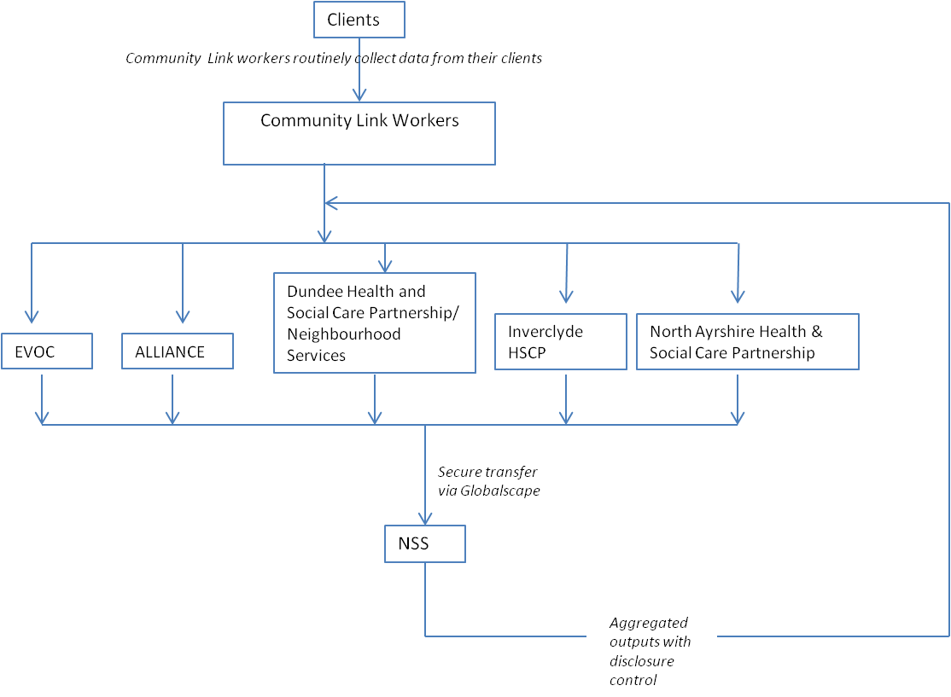
Community Link Workers Data Flow Diagram

Slide 9
Community Link Workers Data Submission – Review
Currently several variations of data submitted
Pilot Area | Minimum Core Dataset
Area 1 | Postcode not recorded – SIMD cannot be derived, 18 local systems will need to be amended.
Area 2 | Should be complete (data not yet received)
Area 3 | ~ 50+ separate file, will varying levels of MCD collected; files need to be standardised and collated.
Area 4 | Currently unable to submit individual client level data; aggregate return only.
Area 5 | Most of MCD data submitted.
Notes:
-

Slide 10
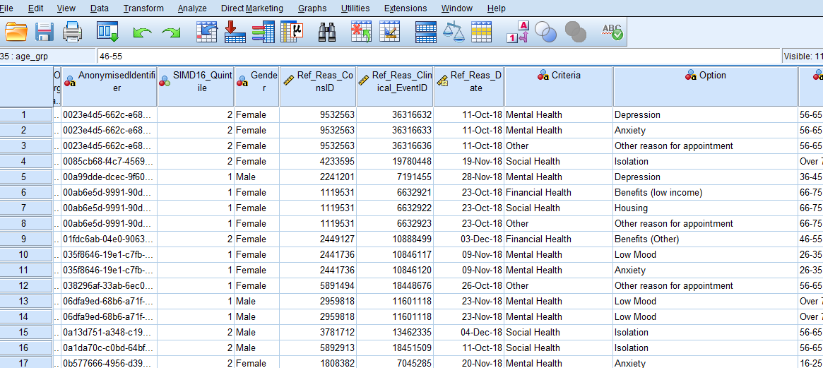
CLW – Data completeness ....Issues
Data submitted /collected on multiple separate files
Data headings not consistent with the MCD list
Format of data are not consistent across all sites
DNA data not submitted
SIMD not recorded in some areas
Referral source not submitted
Referral reasons do not match the CLW core dataset
Multiple reasons for referral submitted
Referral destination incomplete or not recorded
Notes:
Discussion around how to address the variances/issues which cause the lack of standardisation;
Is it resources (people time), technical knowledge, system restrictions
Very difficult task to evaluate at national level without standard data being submitted.
Need to deal with the issues in order to move forwards to standard submissions to be able to produce comparative outputs

Slide 11
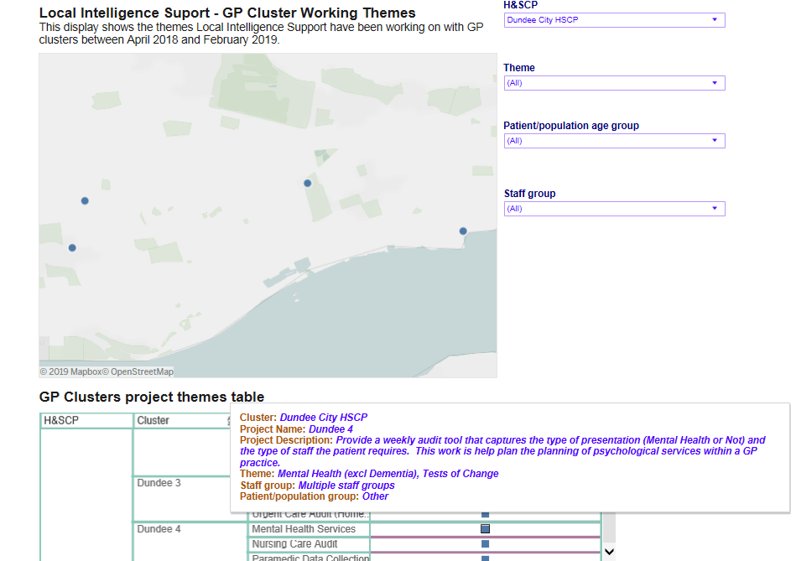
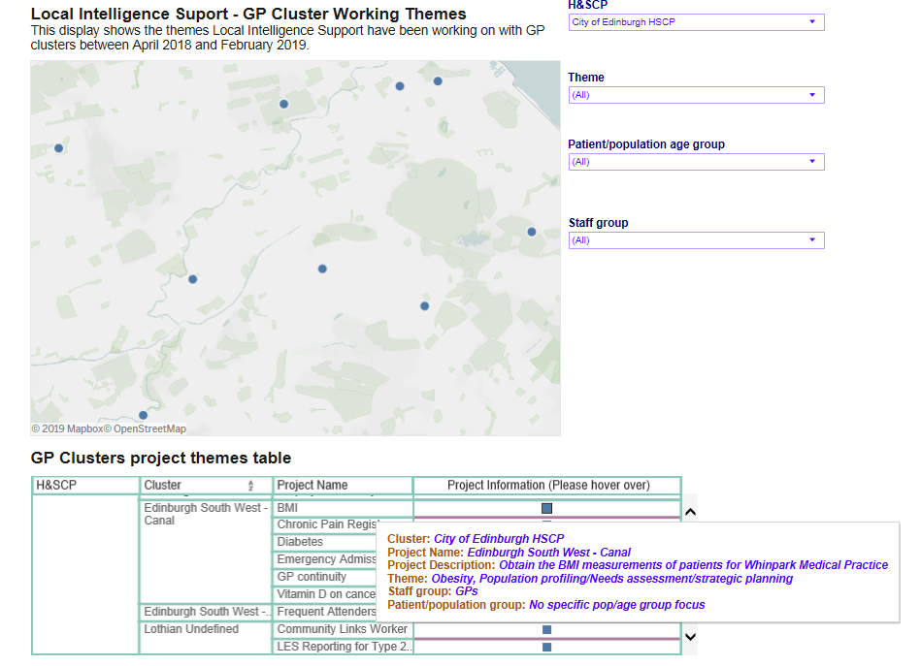
http://www.isdscotland.org/Health-Topics/Health-and-Social-Community-Care/Local-Intelligence-Support-Team/GP-Clusters/cluster-map.asp

Slide 12
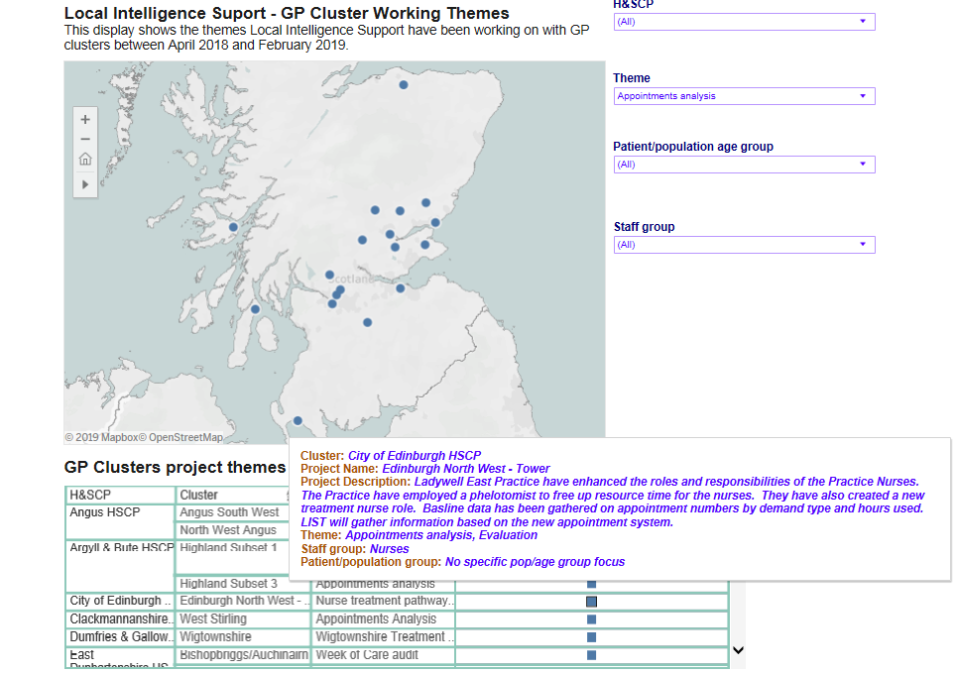

Slide 13
What might the evaluation help us understand?
 | MCD | Qualitative
PATIENTS
Who is receiving the CLW service? |  | 
PRACTICES
How does the CLW programme reduce demand on the GP practice? | Scoping | 
How do different CLW models of delivery influence programme delivery and outcomes (e.g. individual practice vs cluster models of service)? |  | 
Is there any change in nature and source of referrals over time? | 
Does the programme reduce pressure on practice teams for those patients who access the Link Worker service? | Scoping | 
COMMUNITY & THIRD SECTOR
Is the Link Worker programme sustainable? | Scoping | 
Does the Programme enable stronger practice-community relationships? |  | 
SERVICE PLANNING
Is programme information and learning used by HSCPs and CPPs to inform service planning? |  | 
Does the Programme contribute to understanding of local partners to determine how to best address the needs of their populations? |  | 

Slide 14
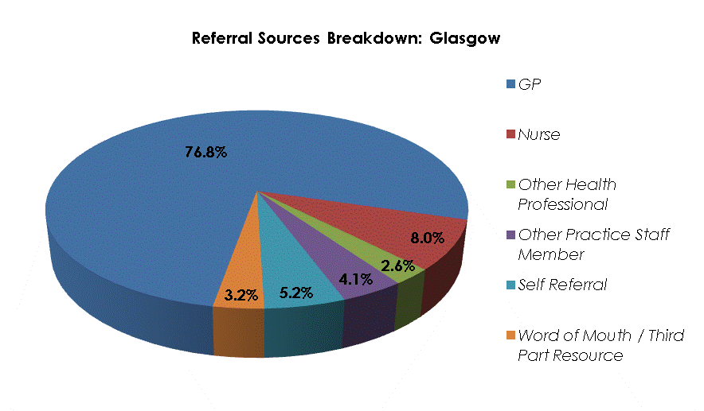
Notes:
Referral Source – initial pathway into CLW service.

Slide 15
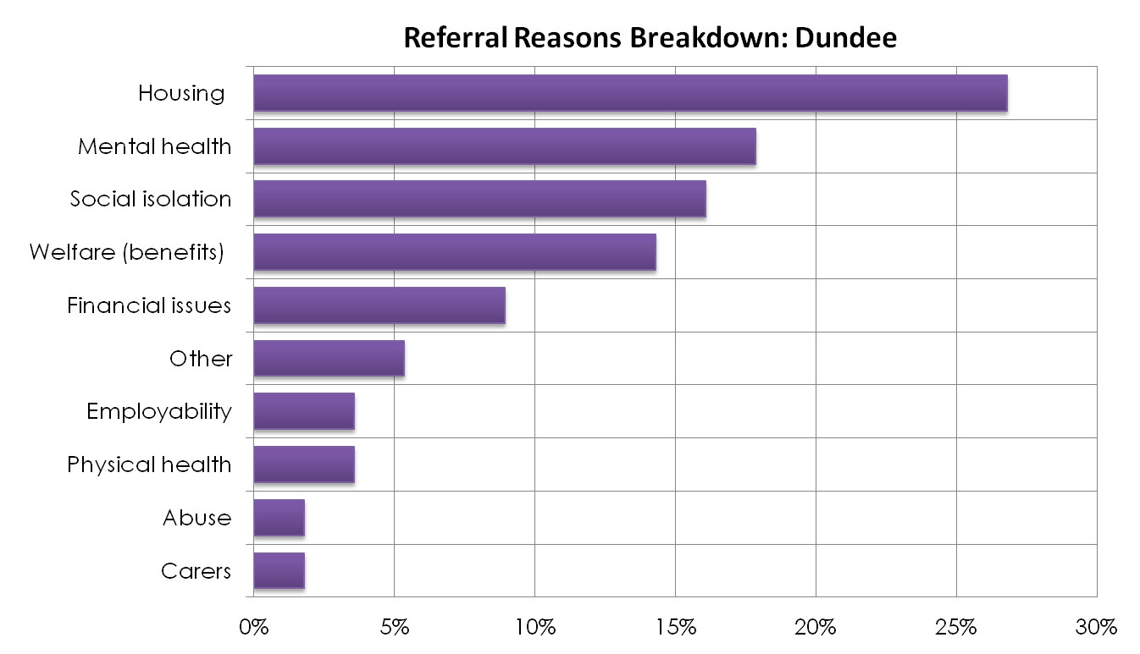
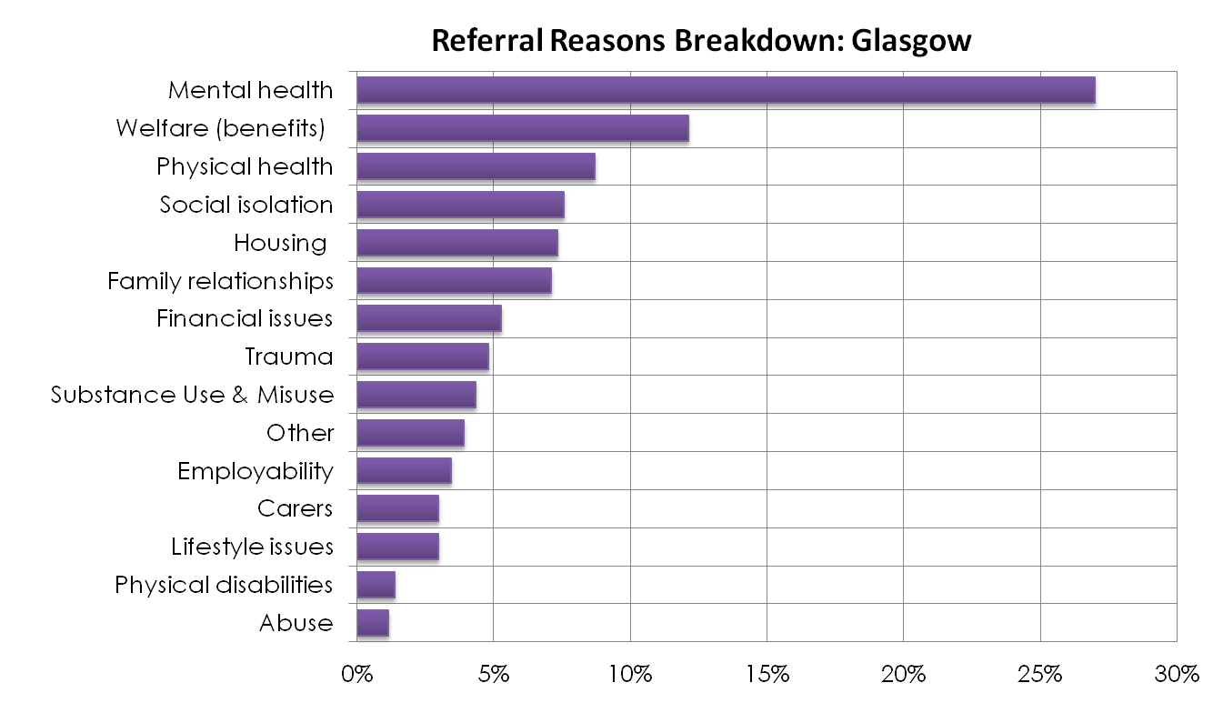
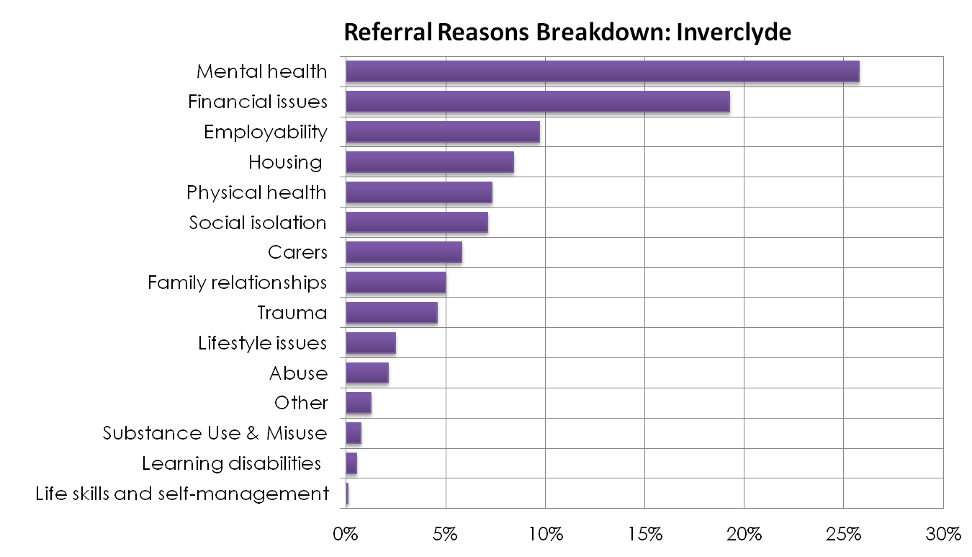
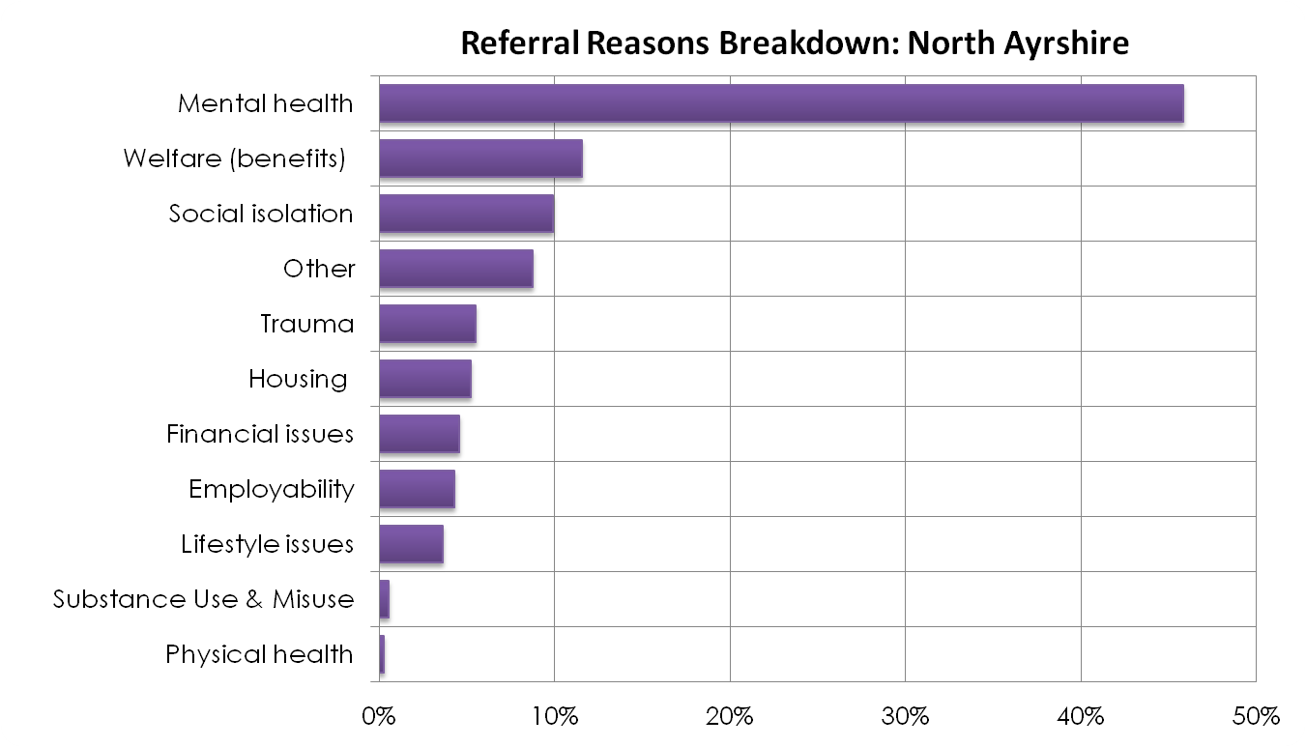
Notes:
Start to build up a picture that reflects similarly characteristics to and ‘All Site’ level, with little changes according to the issues associated with each area as seen in the Community Link Worker project.
...but what about the wider picture and the issues at local authority level – Do these reflect the CLW project results? Could these be representative of the issues seen? It’s always good to have an appreciation and understanding of the bigger picture but could this wider insight help with local planning around the project. Generally, in the context of health and social care an understanding of the health and wellbeing needs of the population is required in order to determine the outcomes that are being sought and the changes and improvements that require to be made in the planning and delivery of services. Ultimately, this is assessing the level of need for health and social care services, describing the current pattern and level of supply of these services and identifying the extent of the gap between need and supply.
e.g. additional link workers overall, those with an expertise in these referral reasons or to ensure the availability of services that are key to the success of the project.
How do we capture and use that information and knowledge effectively.
Lead on to Health related issues associated with each local authority

Slide 16
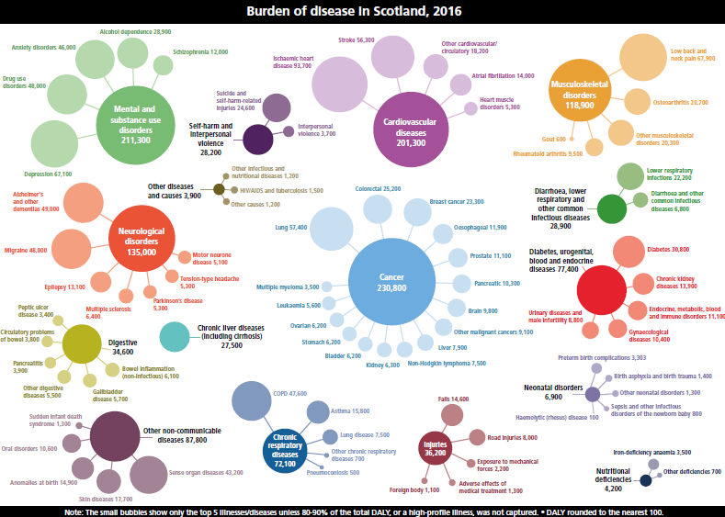
Notes:
Health Related Issues – Burden of Disease Scotland level.
The analysis uses an internationally recognised approach, referred to as ‘Burden of Disease’, to quantify the difference between the ideal of living to old age in good health and the situation where healthy life is shortened by illness, injury, disability and early death. Burden of disease studies use a single measure which combines estimates of fatal and non-fatal burden: years of life lost (YLL) due to premature mortality and years lived with disability (YLD) due to time spent living in less than ideal health. The measure used to describe the overall burden of disease is called the disabilityadjusted life year (DALY). This allows a fairer picture of the contribution of diseases which are unlikely to cause death but may cause substantial poor health.

Slide 17
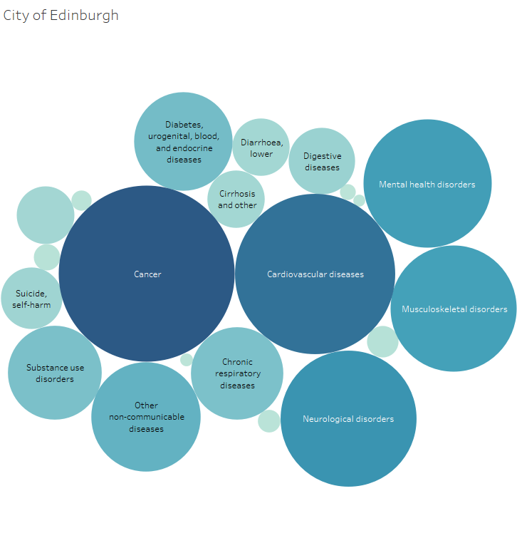
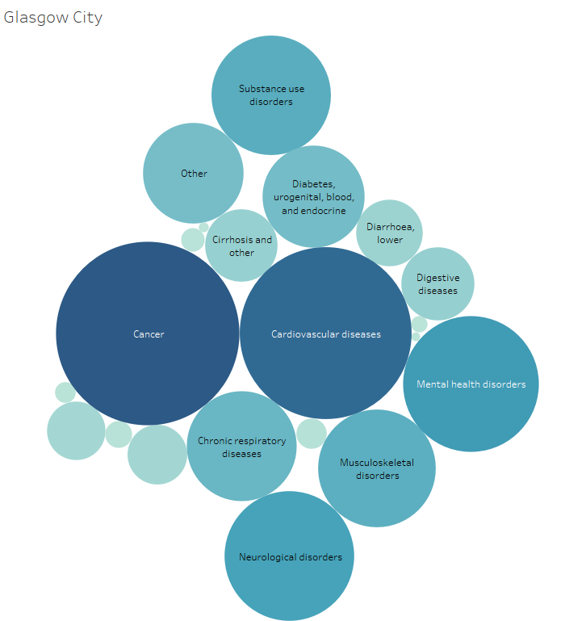
Burden of Disease
https://www.scotpho.org.uk/comparative-health/burden-of-disease/overview/

Slide 18
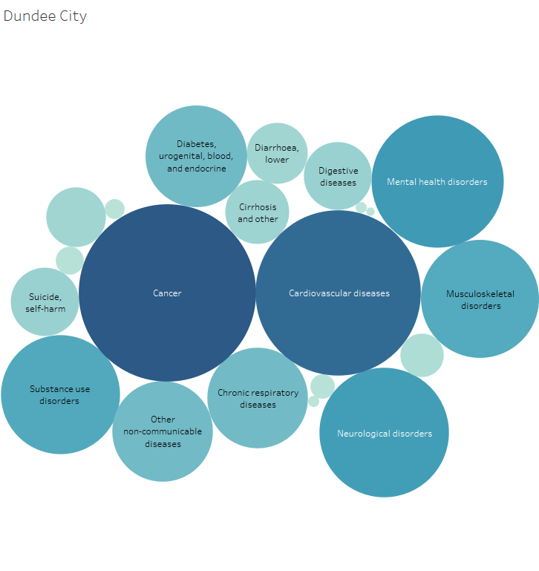
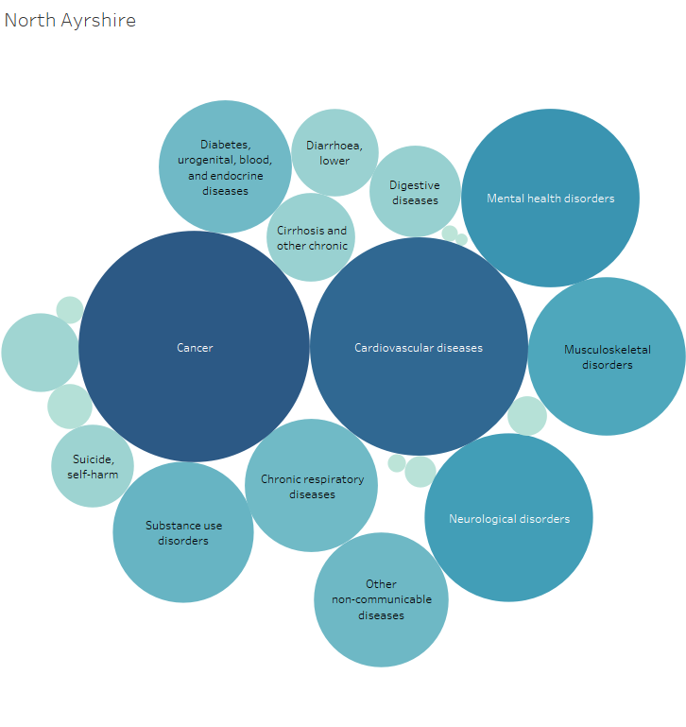
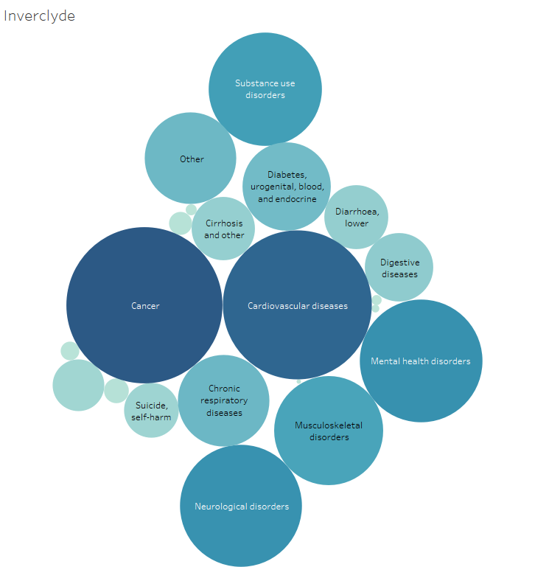

Slide 19
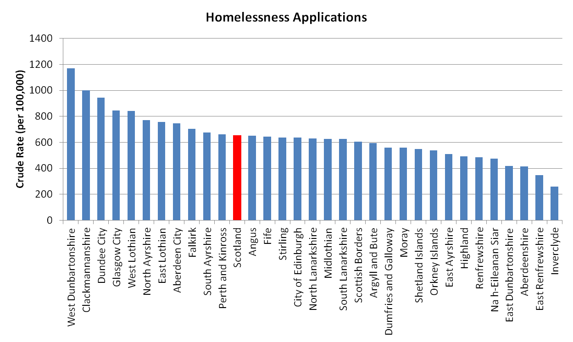
Housing
Source: https://statistics.gov.scot/
Notes:
Other data to inform and supplement the CLW project information – indicates that the pilot sites are above the Scotland level for homelessness applications which does indeed reflect the referral reason distribution seen before, with housing being one of the top referral reasons across each of the sites.

Slide 20
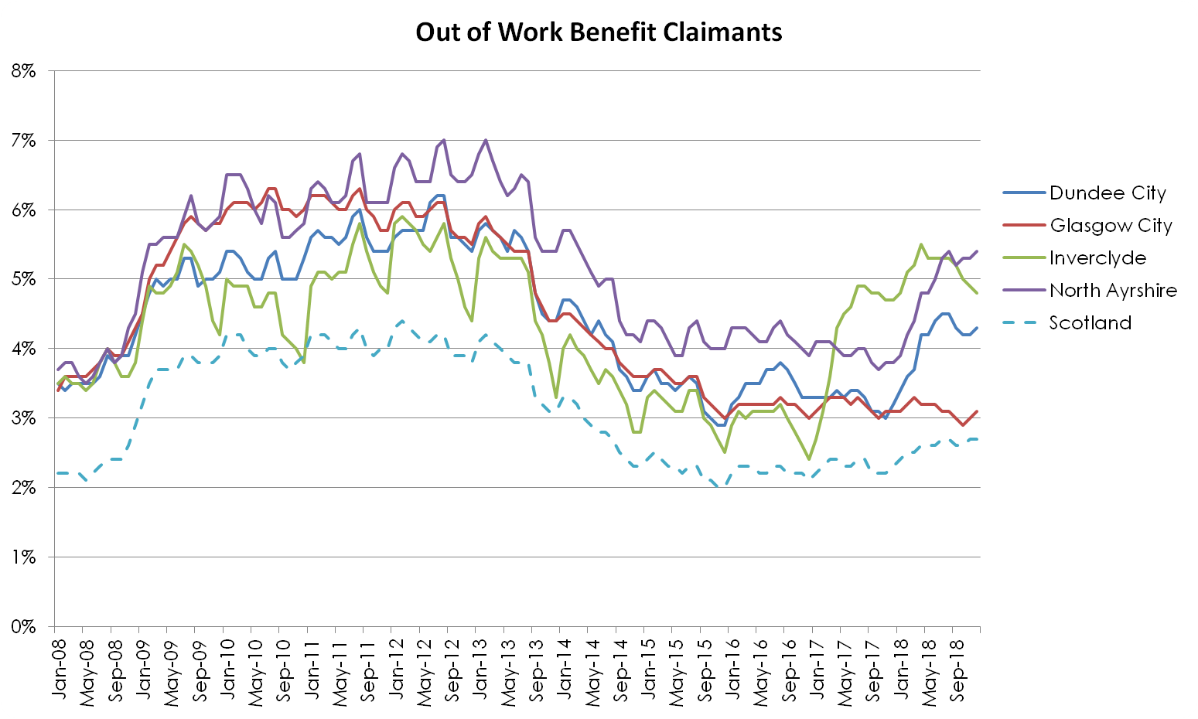
Benefits
Source: https://www.nomisweb.co.uk/default.asp
Notes:
Other data to inform and supplement the CLW project information – similarly indicates that the pilot sites are above the Scotland level out of work benefit claimants which does again reflect the referral reason distribution seen before, with welfare and benefits being one of the top referral reasons across each of the sites.

Slide 21
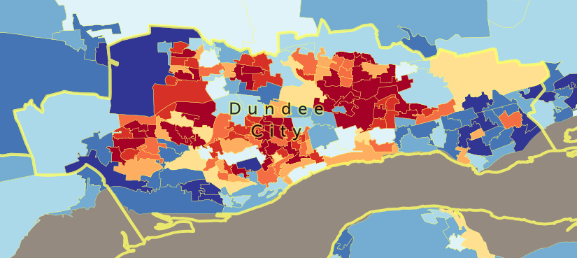
Abuse | LA | Scotland
Incidents of domestic abuse recorded by the police | 141 (n=2103) | 110
Substance Use & Misuse | LA | Scotland
Drug Related Hospital Stays (per 100,000) | 719.5 (n = 968) | 675.5
Alcohol Related Hospital Stays (per 100,000) | 240.2 (n = 339) | 146.9
Drug Related Deaths (per 10,000) | 3.8 (n=57) | 1.7
Long Term Conditions (Locality prevalence per 1,000 of at least one LTC)
Coldside | 223 (n = 4089) | Lochee | 214 (n = 4156)
Dundee East End | 230 (n = 3656) | Maryfield | 165 (n = 3077)
Dundee North East | 187 (n = 2986) | Strathmartine | 216 (n = 4247)
Dundee West End | 136 (n = 2799) | The Ferry | 223 (n = 4496)
Employment & Welfare | LA | Scotland
Economically Active | 71.7% (n = 70800) | 77.4%
Out of Work Benefits | 4.8% (n = 4700) | 3.1%
Jobs Density | 0.85 (n=84000) | 0.81
Fuel Poverty | LA | Scotland
Fuel Poor - 10% of income on household fuel | 30.7% | 27.3%
Extreme Fuel Poor - 20% of income | 7.8% | 7.6%
Notes:
So with this and other bits of related data, we can start to build up a profile that could provide further understanding of the needs of the local area, whilst also potentially being used as an input to inform local planning of CLW services including availability of third sector organisations by anticipating demand.
Chosen a few indicators for Dundee City that are above the Scotland level, indicating the challenges facing the local authority area.
The Scottish Index of Multiple Deprivation (SIMD) combines seven different domains (aspects) of deprivation:
Income
Employment
Health
Education, Skills and Training
Geographic Access to Services
Crime
Housing
These domains are measured using a number of indicators to form ranks for each domain. Data zones are ranked from 1 being most deprived to 6,976 being least deprived. Each of the seven domain ranks are then combined to form the overall SIMD. This provides a measure of relative deprivation at data zone level, so it tells you that one data zone is relatively more deprived than another but not how much more deprived.
Deciles split the datazones into 10 groups, each containing 10% of Scotland’s datazones. Darker red colour is the most deprived, darker blue is the least deprived.

Slide 22
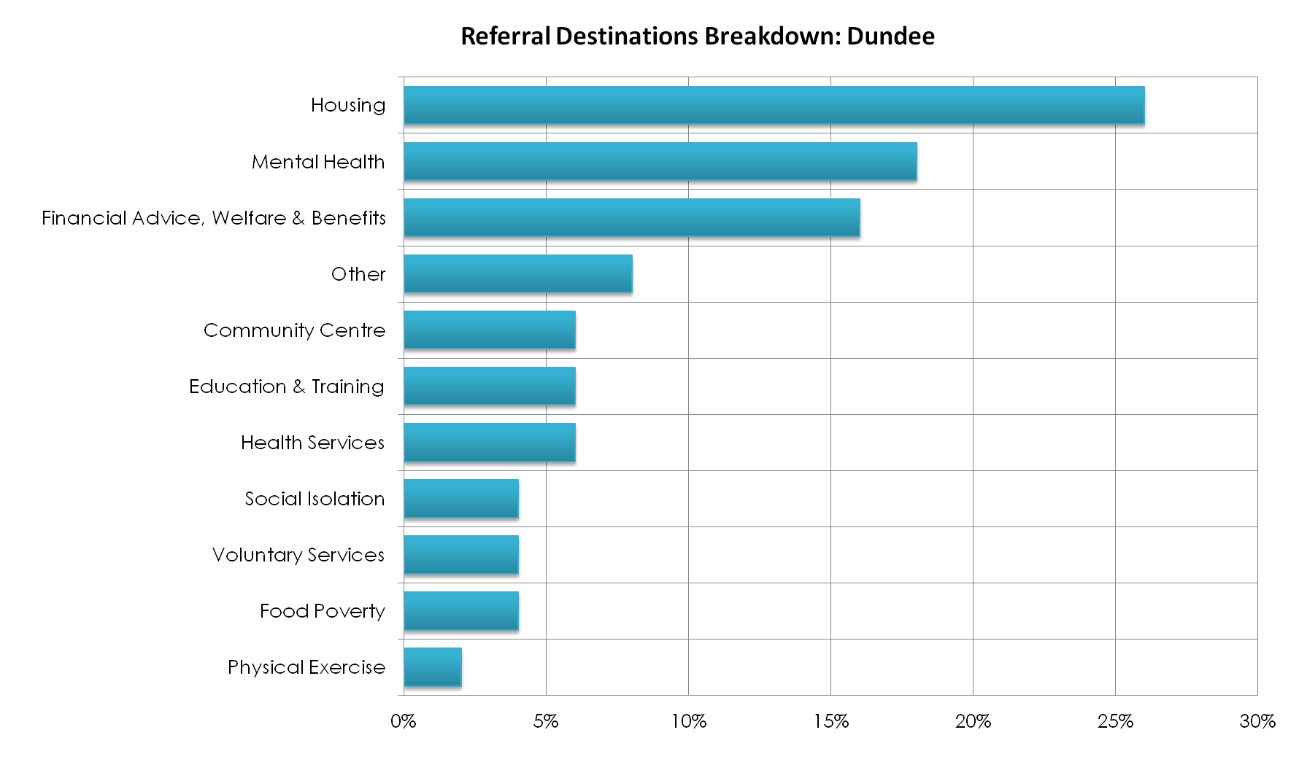
Notes:
Referral Destination

Slide 23
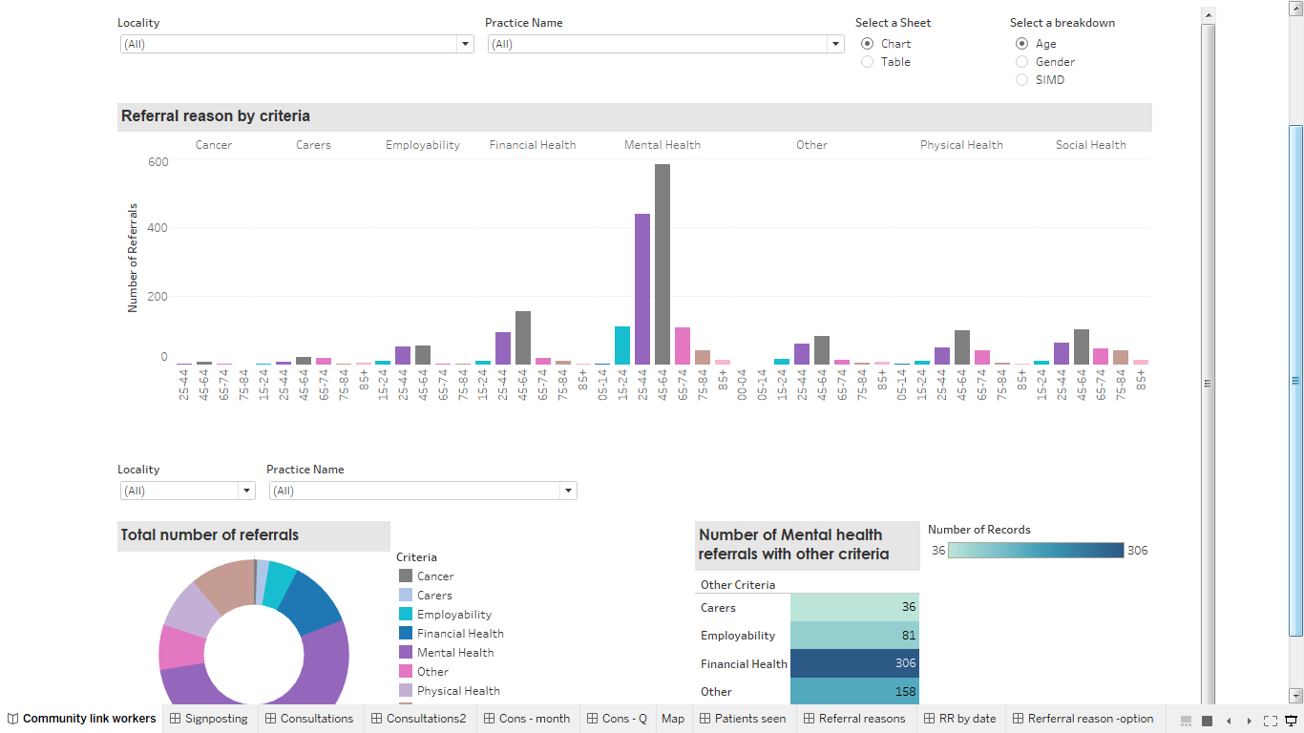
Going Forward......
potential to build dashboards
showing standard outputs
Using agreed visualisation
Reliant on reliable/timely data submissions

Slide 24
Thank you
General Enquiries: nss.LIST@nhs.net
Community Link Workers data nss.clwdata@nhs.net
LIST
(Local
Intelligence Support
Team)

