Slide 1
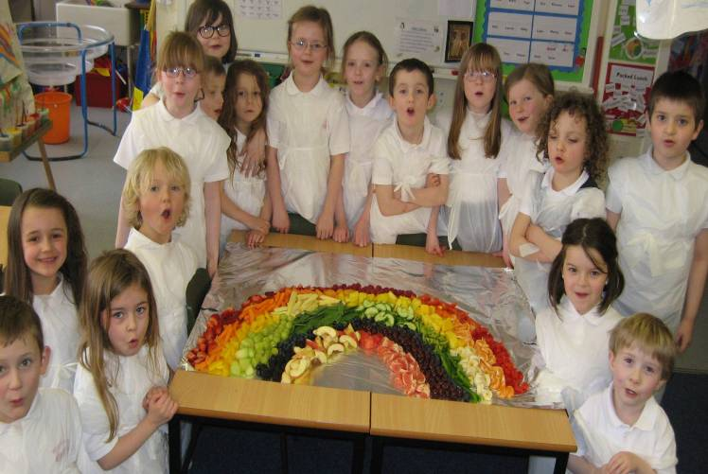
Food & Health in Highland schools in the context of healthy weight and inequalities
David Rex, Specialist Dietitian, Highland Council, Care & Learning Directorate
David.rex2@highland.gov.uk

Slide 2
Food & Health initiatives in Highland Council, Care & Learning Directorate
Bumps to Bairns Food & Health Pages
(www.bumps2bairns.com/food-and-health/)
Smart Start programme for nurseries
Food & Health in Schools group to oversee BEBL
“Childsmile”
High 5 programme for primary schools (www.highfive.scot.nhs.uk)
Food & mood programme for High schools (including teachers)

Slide 3
Indicators of dietary adequacy from the Highland Lifestyle survey
40% of S4 pupils reported not having breakfast on most days
Mean F&V intake self reported by P7, S2 & S4 is stable at 3 a day
50% of S2 pupils reported having no lunch the previous school day
Approx 50% of S2 & S4 pupils had a “street lunch” the previous day
50% rise in pupils reporting 5 or more F&V a day in last 6 years
50% rise in P7 pupils reporting 0 to 1 F&V portions a day in last 4 years

Slide 4
High BMI & diet awareness in the classroom
It already exists
Heavier children often stigmatised for being different
Heavier children are more likely to be from poorer families
Children of average weight, don’t see the need to change what they eat
Must not lose positive messages like frequent, varied and enjoyable eating

Slide 5
Inequalities in school food & health
Impact of street food culture on pupils with FSM entitlement?
Risk of “judging” the diets of poorer families
Cheapest street lunches are often the least healthy
Risk of adding to stigma experienced by heavier children
Risk of not addressing poorest diet among average weight children
Variable policy in schools for charging for home economics
Need to know more about pupils not eating breakfast or lunch

Slide 6
High 5 programme
30 lesson plans o choose from
Links learning in classroom, canteen and school grounds
Positive education about food as nourishment rather than threat
Teachers encouraged to be mindful of inequalities
Specific lessons to promote positive self-esteem and body confidence
Develops critical thinking skills contributing to resilience

Slide 7
High 5 website: www.highfive.scot.nhs.uk

Slide 8
Principles of High 5
Food is good for you!
Healthier choices at any weight
Avoid “good” and “bad” foods
Respect differences (money, culture, medical need etc)
Acknowledge barriers to food and physical activity
Discretionary foods are not “treats” (“Sometimes foods”)
Avoid food snobbery
Involve your cook
Notes:
We have lesson plans that are fully developed. They can be followed to the letter, adapted to suit the needs of your pupils or used more loosely as inspiration. What ever your 8 session program looks like, pay attention to the following principles. These are fully described in the “Key principles of High 5” document on your CD in the High 5 general explanatory notes folder. Talk through the princples, one by one.

Slide 9
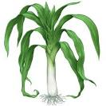

Slide 10
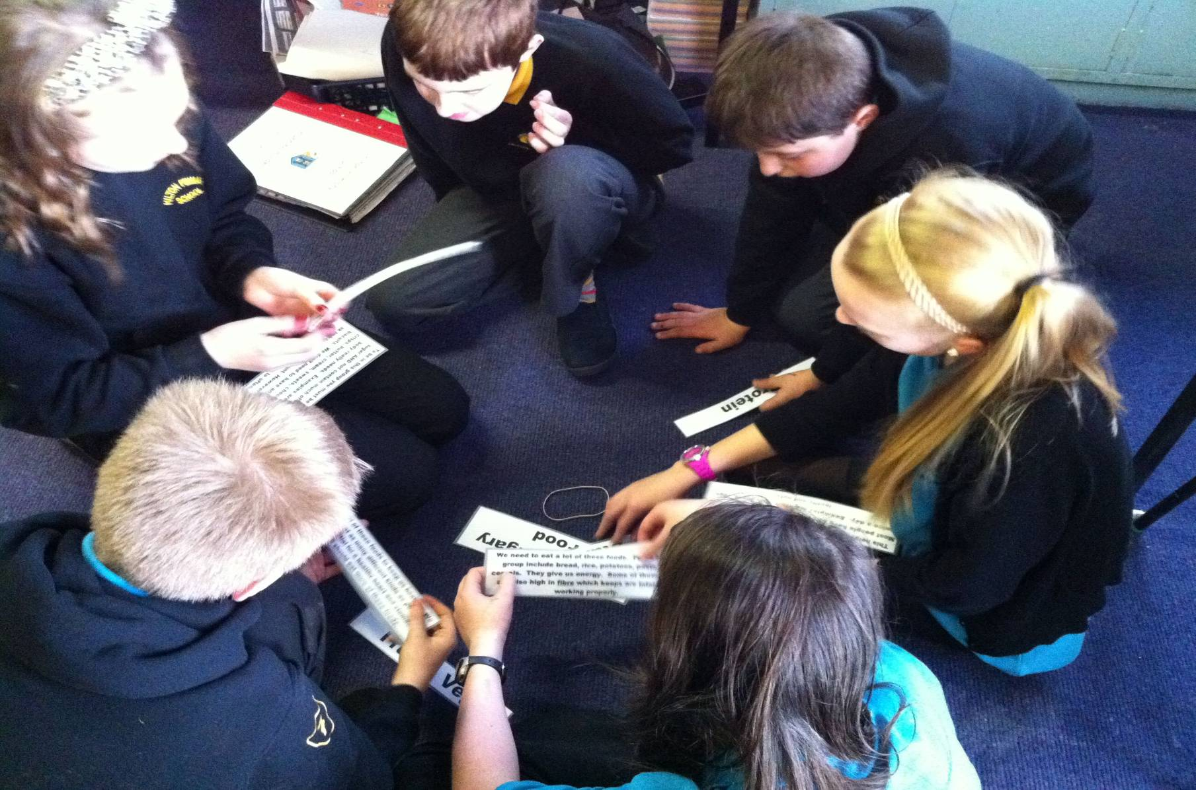
Eatwell Plate in the context of personal choice and external influences
Notes:
The Eatwell Plate is a really important foundation for the mid primary years. It still needs to re-enforced in upper primary. This picture shows primary 7 pupils matching the description of each food group with the name of the food group. The text for these laminated cards was just copied from the extra guidance notes and, if you look in the appropriate Eatwell lesson plan folder, you’ll see these descriptions already formatted and ready for you to print off and cut up…just to make it easier for you and avoid having to duplicate the effort.

Slide 11
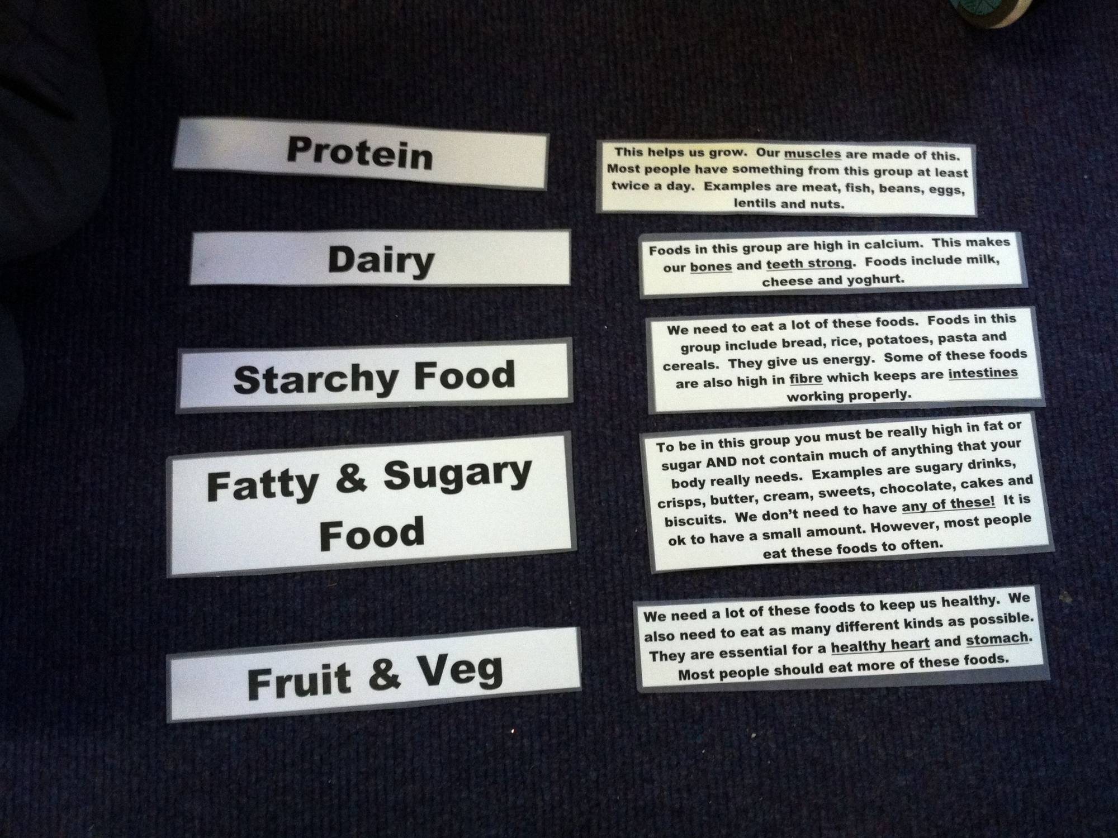
Notes:
And here are the 5 food groups correctly matched up with their descriptive text.

Slide 12
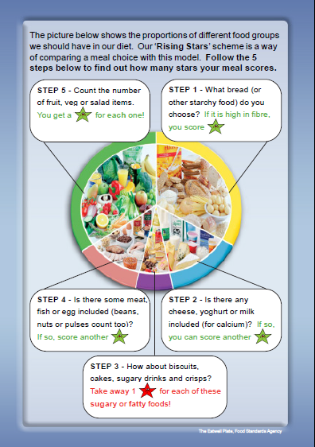
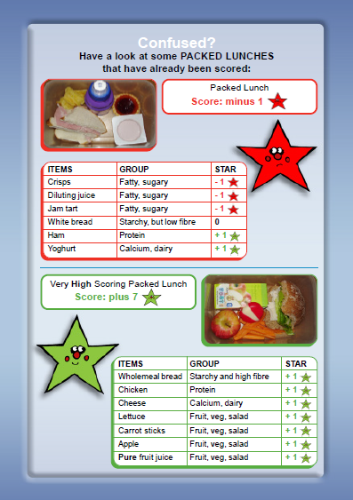
“Rising Stars” – A meal evaluation tool for older primary pupils

Slide 13
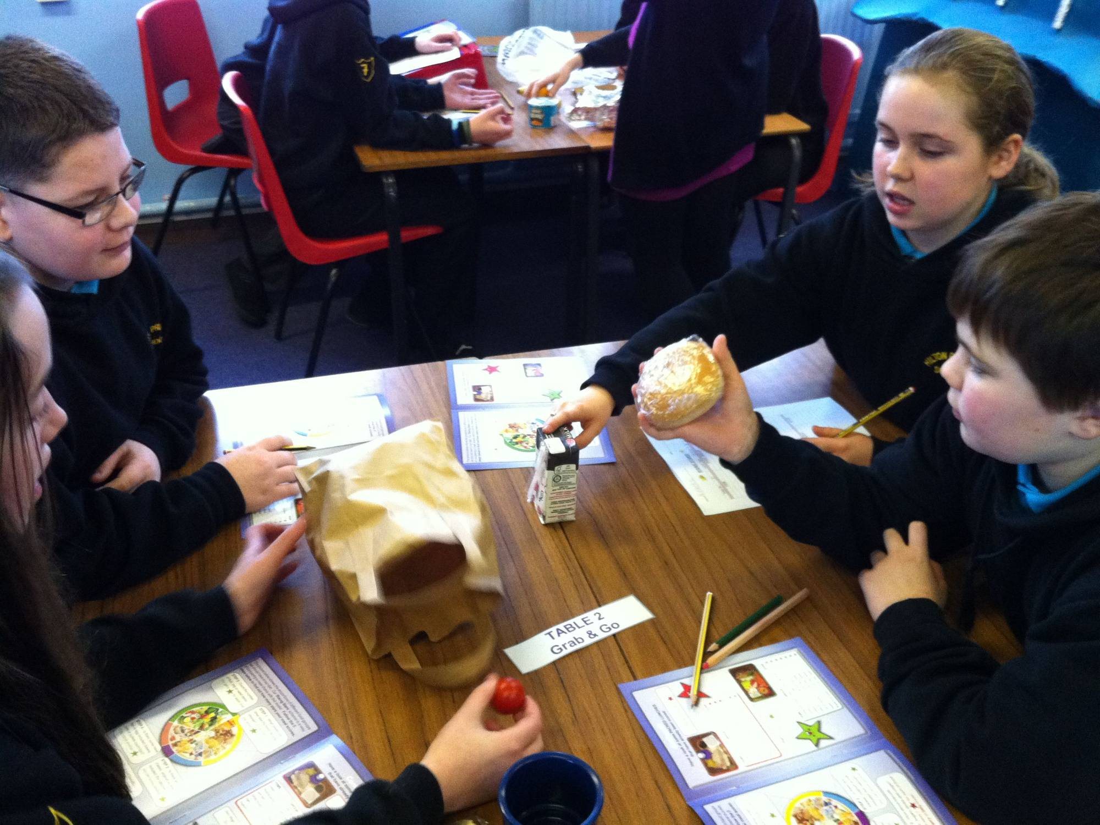
Notes:
Here are some older children practising the Rising stars scoring system.

Slide 14
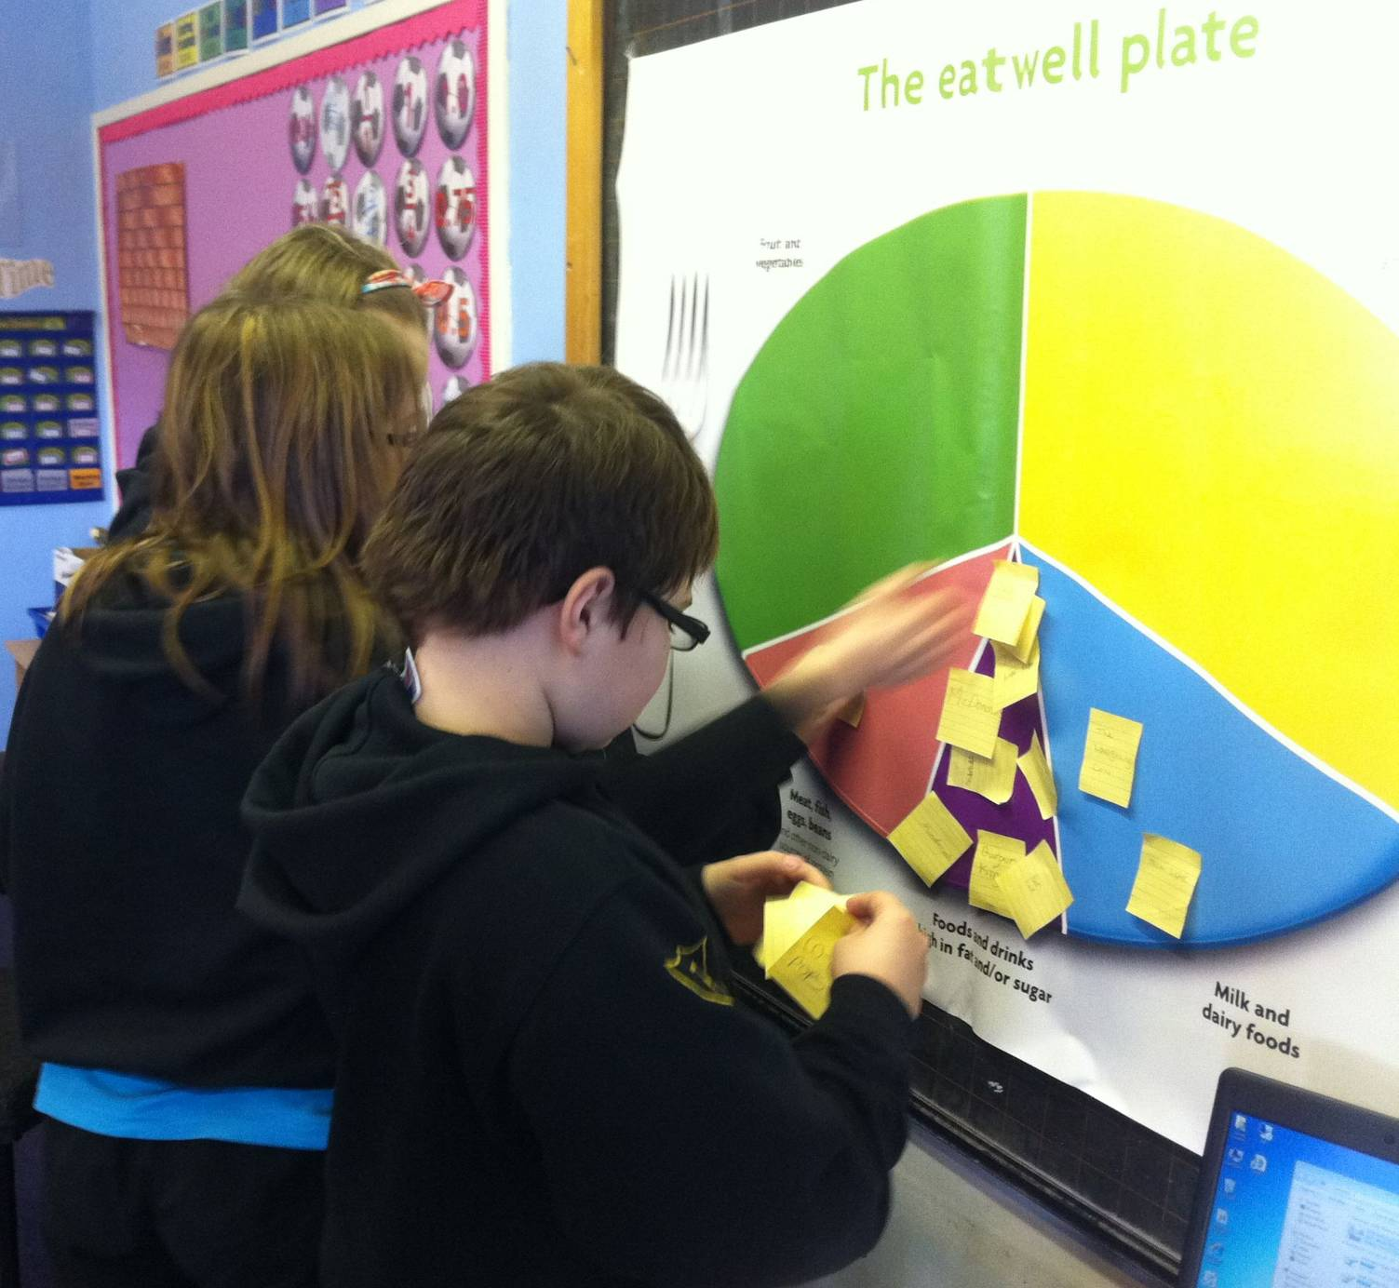
Comparing food advertising with the Eatwell plate
Notes:
Here are some primary 7 pupils putiing the food adverts into the appropriate section of the Eatwell plate.

Slide 15
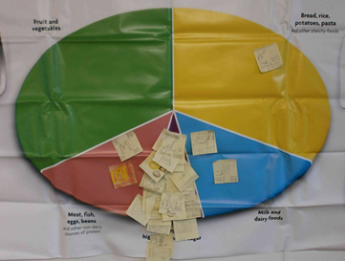
How do you feel about this?...........

Slide 16
