Slide 1

NHS Lothian Weight Management Service
The local experience so far…..
Laurie Eyles and Alison Diamond,
Dietetic Service Lead (job share)
NHS Lothian Weight Management Service
Department of Dietetics, NHS Lothian

Slide 2
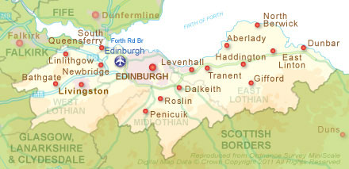
The Lothian landscape
Not just Edinburgh city…4 H&SCPs
Pop: 830,000
>5% of population with T2DM
124 GP practices
Marked inequalities
65% population BMI>30

Slide 3
Establishing the WM service – a timeline
2008:
Bariatric service established with permanent funding
Surgeons
Specialist Nurse
Dietetics
2010:
ORM published
Tier 4 WM Service and Paediatric WM Service (HEAT related funding)
2011-2012:
Dietetic service redesign
Tier 3 WM Community Programme
Exercise Specialist
Psychologist
2013:
Effective Prevention Bundle funding
Tier 2 WM Programme established
Addition of physiotherapist and dietitian
2017:
Fully centralised WM service from T1 – 4
Integration with T2DM prevention

Slide 4
“Get Lighter in Lothian”
The Lothian Weight Management Service (Adults) 2017
Rising Body Mass Index
General population- based advice and services e.g. websites, apps, community initiatives
Tier 1
Local Council and Leisure Trust Health Coaches
12 week dietary (Counterweight) and physical activity group programme
Follow up at 6, 9 and 12 months
FFIT pilot
Tier 2: Get Moving with Counterweight
Community Dietetic Team and Specialist Weight Management Team
14 week core group programme
9 month maintenance group programme
12 week Exercise group programme
(4 psycho-educational talks)
+/- psychological 1:1 therapy
Tier 3: Get Lighter
Specialist Weight Management Team
Advanced Weight Management
1:1 consultations with specialist dietitian or psychologist
Orlistat/Counterweight Plus/BEYOND study
Tier 4
Tier 5
Bariatric Surgery
Patient information seminar
12 week ‘IPIC’ programme
Further 12 week 1:1 if required
Number of Affected People

Slide 5
Who is it for?
Single point of referral to adult and paediatric weight management
Referral criteria:
Overweight and obese adults (>18 years) with a BMI>30kg/m² (BMI>27.5m² If BME inc. South Asian and Chinese)
Children > age 5 with BMI >91st Centile, (age 2-5 with BMI> 99.6th centile)
Those who are motivated and ready to make lifestyle changes
Individuals who are able to make independent choices about food shopping and meal planning
Those not appropriate for referral:
  Have uncontrolled hypothyroidism
  Have unstable psychosis or severe and unstable personality disorder
  Have current alcohol or drug abuse
  Are pregnant
  Have dementia
  Have diagnosis of current eating disorder
  Have moderate to severe learning disability

Slide 6


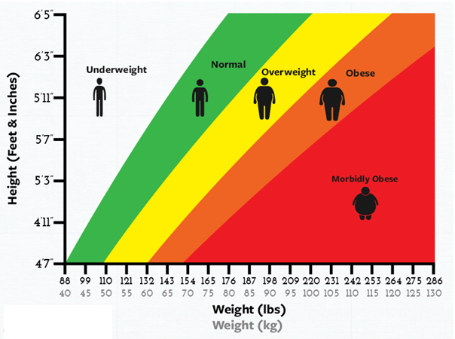
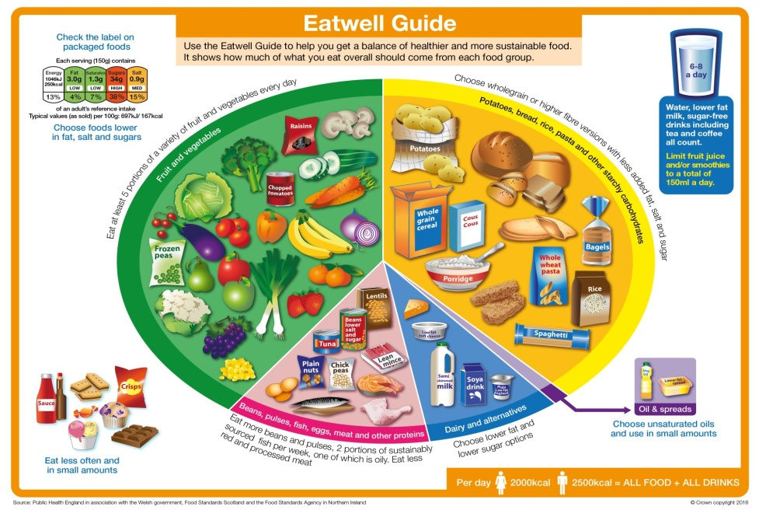
Tier 1
Ongoing development, focusing on national resources and core messages across H&SCPs and health boards
Working closely with Maternal and Infant nutrition strategy
Collaboration with Health Promotion
Early years and schools

Slide 7
Tier 2 or Tier 3 – what’s the difference in the adult group programmes available in Lothian?
Tier 2
Delivered by local authority
No dietetic assessment
Not wishing to proceed to bariatric surgery
BMI >30kg/m2
Minimal co-morbs
Physically mobile
Tier 3
Delivered by dietitians
Full dietetic assessment
May wish to proceed to bariatric surgery
BMI >35kg/m2 with co-morbs
BMI >40kg/m2 with/without co-morbs
May be less physically mobile/ have more complex health needs

Slide 8







Tier 2 Weight Management
Get Moving with Counterweight
Notes:
Introduction
Who I am
What I do: Get Going (Paed) and Adult Tier 2 prog. GM
How I do what I do (Involved in delivery and overseeing of the programmes since 2015)

Slide 9
Timeline of Partnership between NHS and Local Authorities
Overview of Tier 2 Intervention
Course Statistics
Challenges
Successes
Notes:
The run through of what I'm going to discuss over the next 20 minutes:
Timeline of NHS and Local Authority Partnership (4 years)
overview of Tier 2 Intervention (Delivery model across Lothians)
Course Statistics (Highlights and achievements)
Challenges (familiar and commonly faced)
Successes (Qualitative and a short video)

Slide 10
Timeline of NHS and Local Authority Partnership
Steering Groups
Service Level Agreements
Counterweight
Notes:
Tier 2 Get Moving programme launched 4 years ago
Lothian Wide Steering Group Meetings (NHS Weight Management leads, Admin, Dieticians, Local Autority Co-ordinators and deliverers)
Every 6-8 weeks to begin with > Quarterly > Bi-annually (more autonomous due to success of programme)
Service Level Agreements agreed between each locality and the NHS on what would be expected between the partnership in order to get the best outcome for patients in the community
Counterweight was the approved delivery model NHS and Local Authorities would adopt within Tier 2

Slide 11
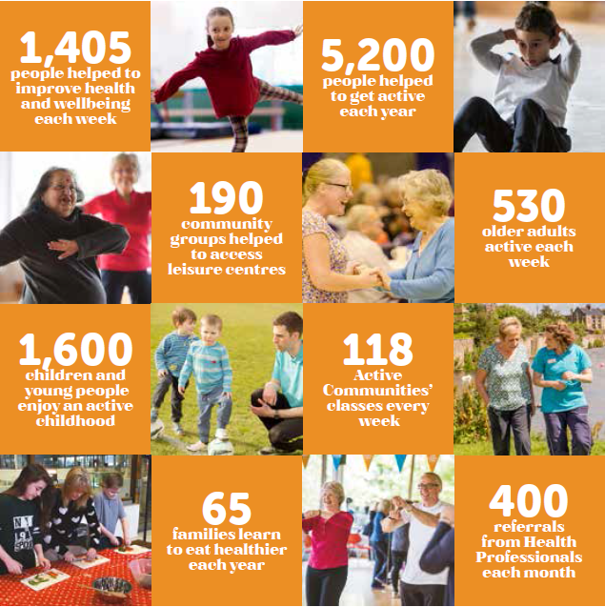
Edinburgh Leisure & Active Communities –
helping people get active
Our Active Communities team use the power of sport and physical activity to help those in need improve their health and wellbeing…
working collaboratively improve health and wellbeing
Notes:
At Edinburgh Leisure we work with a wide range of partners to inspire Edinburgh to be more active and healthy
Our Active Communities team use the power of sport and physical activity to help those in need improve their health and wellbeing
working collaboratively to improve health and wellbeing
That’s important…….We have a common purpose with our health partners ‘ a healthier city’
Last year we received £530k external funding from NHS, Health & Social Care, CEC & Third Sector for delivery of our Health and Community Development programmes.

Slide 12
Tier 2 – Referral Criteria
Tier 2
Delivered by local authority
Central referral point
Not wishing to proceed to bariatric surgery
BMI >30kg/m2
Minimal co-morbs
Physically mobile
Capacity for:
24 Groups in Edinburgh; 14 in West Lothian; 8 in East Lothian and 9 in Midlothian
Groups held in local venues on evenings and weekends
Patients positively book into the programme
Follow up at 6, 9 and 12 months
Notes:
Central Referral Point (AAH) > Triaged > Opt in > Refs Sent via NHSmail to Local Authorities
Delivery capacity within Local Authorities agreed in SLA (24 Groups in Edinburgh; 14 in West Lothian; 8 in East Lothian and 9 in Midlothian)

Slide 13
Overview of Tier 2 Intervention patient journey
Weight Management Service responsible for referral process, triage, administration of groups and training and mentoring of health and leisure delivery staff
12 week course delivered in Local Authority (combining education and physical activity)
3, 6 and 9 month review sessions
Long term support
Notes:
NHS also support with training, resourcing all of the materials and any patient issues
LA then deliver content and entirety of patients journey for 12 months
Send quarterly reports back to the NHS with all expected data stated in SLA (Registers; Weights + Additional Info)

Slide 14
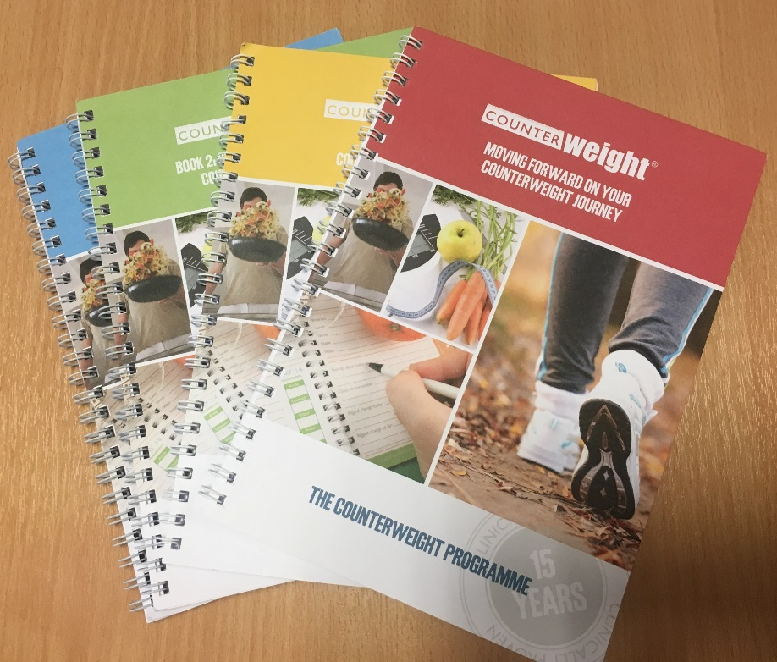
Counterweight
Resources…
Notes:
Counterweight is internationally recognised evidence based and peer reviewed weight loss program.
12 month health eating and lifestyle programme with the purpose of achieving long term stable weight loss.
Running for 10 years and the only fully evaluated, cost effective, evidence based primary care weight loss programme currently available in the UK showing sustained weight loss
The additional benefit to this for NHS Lothian is that it would ensure a co-ordinated delivery approach across all areas and local authorities
Pick up and Go resource – covers all areas and aspects you’d expect within a Weight Loss programme…

Slide 15
Overview of Tier 2 Intervention
Weight loss goals and energy requirements
Healthy eating and active living
Understanding food labels
Healthy shopping, cooking and eating out
Eating habits and emotions
How to prevent lapsing and relapsing
Maintaining your weight permanently
Notes:
Educational appointments delivered across 12 weeks
Achieve and maintain medically valuable weight loss of 5-10%
Sustainable changes to eating and physical activity behaviours
Maintain weight loss long term
Improve health status

Slide 16



Staffing
Staff are physical activity experts who are qualified:
REPS level 3 Exercise Referral level
CIMSPA Practitioner affiliated
Counterweight Trained
Often dual programme competent
  Get Going
Notes:
Enthusiastic and Passionate staff towards the area of work
Committed to the programme and have developed a strong partnership between NHS and Local Authorities
Often dual programme trained
Co-morbs associated with Obesity

Slide 17



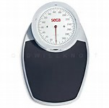
Tier 2: Stats 2014 - 2017
Lothian wide referrals (95% from GPs)
Referrals for Tier 2 – total = 4093
Weight Loss outcomes (average %)
Total = 3214
Total = 879
F
M
3.4%
F
Mean
age
Mean
Weight (kg)
Mean
BMI (kg/m2)
% opt in
4.8%
51%
42
101
34.95
M
Females
41%
48
115
37.12
Males
Notes:
Slide highlights the main statistics since the start of Tier 2 back in 2014
Figures in Red are Female and in Blue is Male
Referrals: 3214 female vs 879 males
Opt in: 51% female and 41% male
Mean age: 42 female and 48 male
Mean weight: 101kg female and 115kg male
Mean BMI: 34.95 female and 37.12 male
Weight loss outcomes
Females - 3.4% weight loss across 12 week initiative
Males – 4.8% weight loss across 12 week initiative

Slide 18
Challenges
Funding
Drop outs
Waiting Lists
Notes:
1 year/Year to Year funding
Challenging for long term planning
Fears for being able to dis-continue support for service and its participants
Staffing worries
Expected Health Referral drop out (UK wide is 60% as a KPI)
In line with the majority of Tier 2 health programmes, it is expected that only 60% of participants will complete
In Edinburgh and across many Lothians we achieved slightly higher around 70%, but still face the same challenges of frustrating drop outs
Waiting Lists
Now that the majority of Local Authorities are delivering to capacity (For example within Edinburgh, 6 courses per quarter with 15 persons per course) it is resulting in waiting lists
Courses full in 2018 until April
Often the answer to this would be more/longer term funding to be able to have greater resource (challenges all Health and Public sectors are facing)

Slide 19
Qualitative Feedback over the past 12 months…
A combined weight loss of 453.14kg (71 stone)
93% report an increase in physical activity levels
74% report an increase in knowledge on how to lead a healthier lifestyle
78% report an increase in confidence
67% improved their diet significantly
67% report an improvement in overall health
Notes:
Finish off with some more significant softer evaluation which has been gathered in Edinburgh in 2017.
A combined weight loss of 453.14kg (71 stone)
93% report an increase in physical activity levels
74% report an increase in knowledge on how to lead a healthier lifestyle
78% report an increase in confidence
67% improved their diet significantly
67% report an improvement in overall health

Slide 20
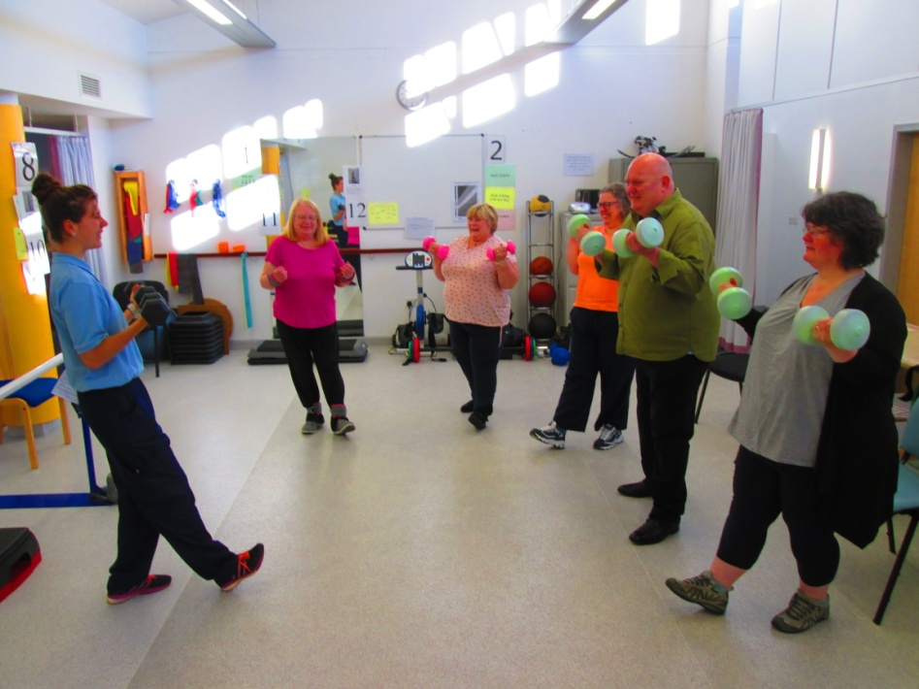
Tier 3 Core Programme and Maintenance
Initial 1:1 assessment and psychological screening
12 week core programme of dietary education and behaviour change delivered by specialist dietitians across H&SCPs
Approximately 1500 referrals/year to Tier 3 level, increasing annually
Then 9 month weight loss maintenance programme, total 12 months intervention
Accompanied by 12 week physical activity programme delivered by WM exercise specialist

Slide 21
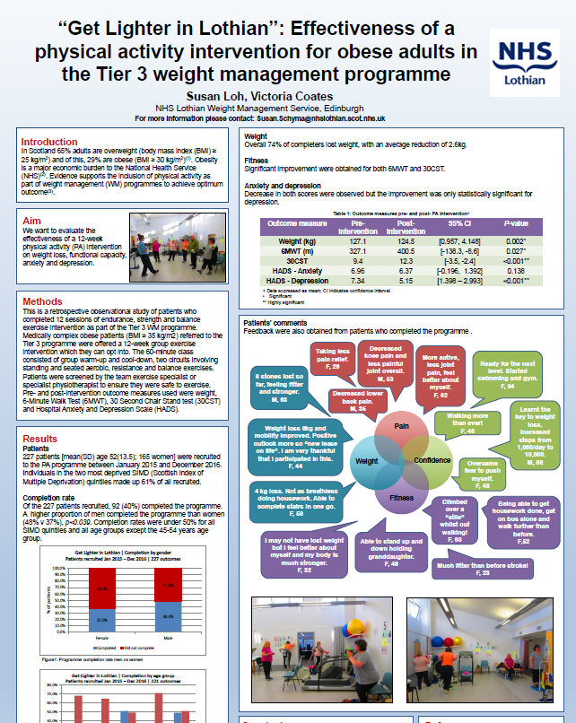
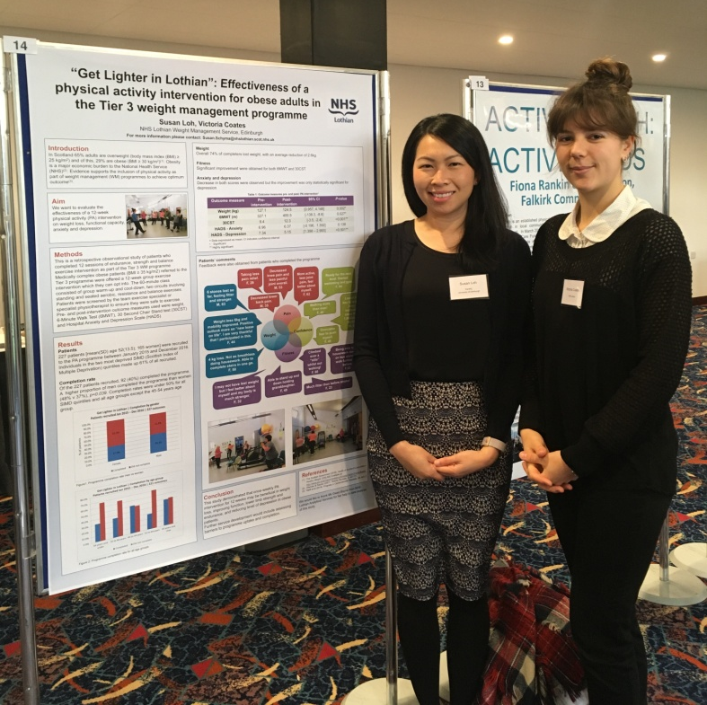
Avge. weight reduction 2.6kg
Improvement in Sit to Stand and walking tolerance
Statistically significant improvement in depression score (HADS)

Slide 22

WM Psychology
Development of Disordered Eating Group
Eat. Think. Change (ETC) for patients who present with clinically significant DE
Screened at dietetic Tier 3 assessment using standard questionnaires
1:1 assessment with psychologist before group
ETC comprises of 11, weekly 2 hour sessions
Co-delivered by Psychologist and Specialist WM Dietitian, using combination of CBT and CFT based approaches
3 months of treatment within ETC then progression to Weight Management group programme OR onwards referral pathway to eating disorder services

Slide 23

TIER 4 – Get Individual
One to one consultations by specialist weight management dietitian and or team physiotherapist or psychologist – referred directly from tier 3
These sessions for
  more in depth personal therapy
  assignment to Counterweight Plus Pilot
  assessment and onward referral to Bariatric Surgical team ( TIER 5)

Slide 24

Counterweight Plus Pilot – 40 patients
12 week low calorie diet using shakes, 12 weeks food reintroduction, 6 months follow up
Steering Group established
Staff trained
Patient selection criteria agreed
Implementation plan agreed
Pilot delivered – great results
Similar process to DiReCT – Diabetes Remission Clinical Trial

Slide 25
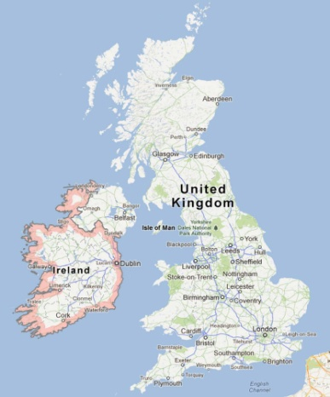
DiRECT Clinical Trial
Study Details
Cluster Randomised Controlled Trial
Control: Current best practice T2DM care
Intervention: add Counterweight Plus
Recruit: 280 patients from at least 20 practices
Inclusion Criteria
Type 2 diabetes < 6 years
20 to 65 years
BMI > 27 kg/m² and < 45kg/m²
Baseline
12 Month
24 Month

Slide 26
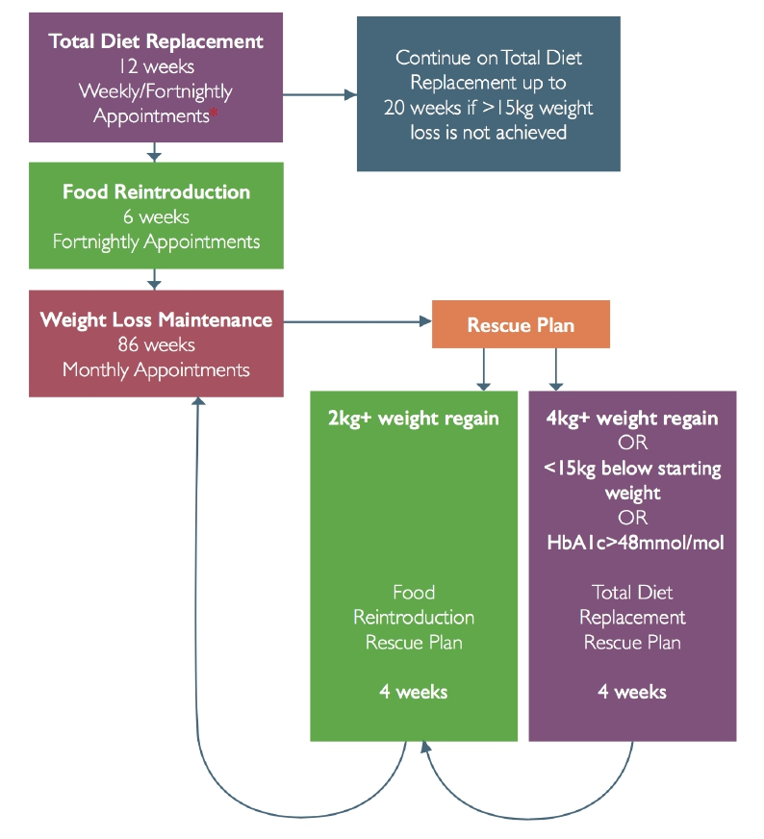
Counterweight Pro800
Nutritionally complete Total Diet Replacement
Sachets come as shakes and soups
55% Cho, 25% Pro, 13% Fat
Food reintroduction
Based on eatwell plate
Portion control
Up to 400kcal per meal

Slide 27

DiRECT Study results – 1 yr
Published internationally on Tuesday in Lancet
24% achieved 15kg or more weight loss vs. 0% in the control group
46% achieved remission, vs. 4% in the control group
87% or 9/10 achieving 15kg or more weight loss achieved remission
Mean weight loss 10kg in the intervention group vs. 1kg in control group
Improvements in quality of life, and minimal (4%) serious adverse events in the intervention group

Slide 28
More about targeted diabetes work streams....
We have an established Weight Management Service – adults and children - following a Tiered model of care
We have a Diabetes MCN – with Prevention as core work stream
We have a pre-diabetes programme running as pilot
We have bi-annual Patient and Professional Conference
We have an established regional diabetes service
We have established ongoing education programmes
  DESMOND, DAFNE, RECLAIM, implementing STEP
BUT we realise this is alone would never be enough…so next step...

Slide 29
Lothian proposal for diabetes prevention strategy
Level 3
Targeted intervention
Level 2
Early intervention
Level 1
Prevention of Type 2 Diabetes
Level
4 Complex
Level 4 - T2DM diagnosed, complex:
Specialist intervention, secondary care case management, tier 4 and 5 weight management service
Level 3 - T2DM diagnosed, GP refer to:
DESMOND programme and Tier 2 or 3 Weight Management Service (if BMI>30 kg/m²)
Level 2 – diagnosis of pre-diabetes, GDM or at high risk*, GP refer to:
6 week pre-diabetes programme
Tier 2 Weight Management Service (if BMI>30 kg/m²)
Metabolic Antenatal Clinic
Level 1 – Early intervention for at risk*:
6 week health and wellbeing programmes
Signposting to further support e.g. physical activity groups in local community, cooking groups etc
Signposting to self-management e.g. websites, apps, wearable technology
Social prescribing and Links Workers
*using either a nationally agreed risk programme, or nationally defined set of criteria – to be agreed multilaterally

Slide 30
What are current work streams and ongoing developments?
Diet and Obesity strategy and associated funding – proposed £42m/5 years
Integration of Type 2 Diabetes Prevention Agenda
Further develop pathways with:
  Antenatal, Maternal and Infant nutrition
  Learning Disabilities and mental health
Develop disordered eating group in paediatric WM
Clinical research in service – dietetic and nursing PhDs
Florence and digital health
Ongoing DiRECT input
Secondary Care Diabetes test for Change with Counterweight with T2Dm on Insulin patients

Slide 31
What have we learned so far?
Obesity prevention and management is complex
Our multi-disciplinary team is key to the success of the service
But year on year uncertainty about funding undermines success and presents a major challenge nationally
Centralised point of referral, referral criteria and triage has been instrumental
Imperative to have strong, visible local leadership and close ties to decision makers
Grasp all new opportunities and run with them!
Ultimately, patients are the centre of the service........

Slide 32
Patient story video

Slide 33
Any questions ?
OUR contact details :
Laurie Eyles and Alison Diamond (Service Lead Job Share)
Weight Management Team
Woodlands House, Astley Ainslie Hospital
Morningside, Edinburgh, EH9 2TB
Phone : 0131 537 9169
Email : laurie.eyles@nhslothian.scot.nhs.uk or alison.diamond@nhslothian.scot.nhs.uk
Or weight.management@nhslothian.scot.nhs.uk

