Slide 1
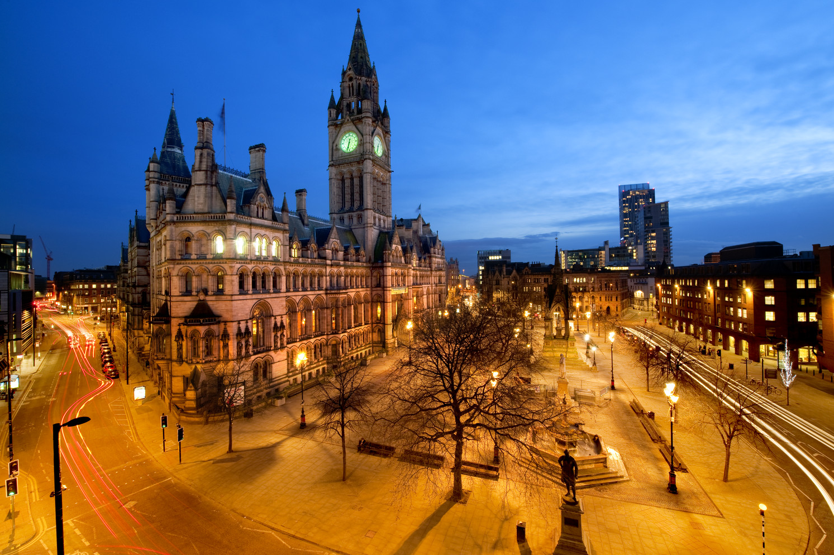



The Paris Agreement to local action on Climate Change:
developing carbon budgets and ambitious action in Greater Manchester
Carly McLachlan, Professor Climate and Energy Policy, Director Tyndall Centre.
Kevin Anderson, Professor of Energy and Climate Change
Notes:
'The Paris Agreement to local action on Climate Change: developing carbon budgets and ambitious action in Greater Manchester’'The Paris Agreement to local action on Climate Change: developing carbon budgets and ambitious action in Greater Manchester’'The Paris Agreement to local action on Climate Change: developing carbon budgets and ambitious action in Greater Manchester’

Slide 2
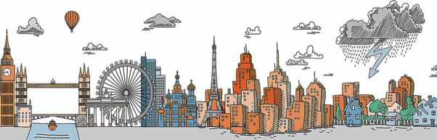
Tyndall Centre
Providing evidence to inform society’s transition to a sustainable low-carbon and climate resilient future.
A network of universities bringing together researchers from the social and natural sciences and engineering to develop sustainable responses to climate change.
Founded in 2000 to conduct cutting edge, interdisciplinary research, and provide a conduit between scientists and policymakers.
Nearly 200 members ranging from PhD researchers to Professors.

Slide 3



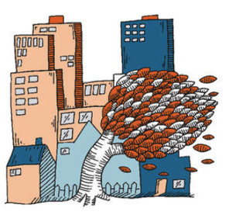
Tyndall Centre
Accelerating social transitions
Overcoming poverty with climate actions
Reaching zero emissions
Building Up Resilience

Slide 4
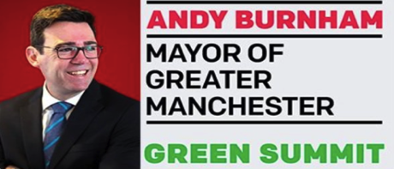
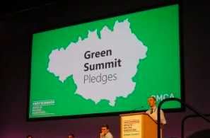
Greater Manchester – ambition and engagement
Andy Burnham commitment to bringing forward the climate change goals for Greater Manchester – based on our work.
700 people and live streamed
Over 40 listening events

Slide 5
Winning slowly is basically the same thing as loosing outright. In the face of both triumphant denialism and predatory delay, trying to achieve climate action by doing the same things, the same old ways means defeat. It guarantees defeat.
Alex Steffan 2017

Slide 6
Tackling climate change requires new thinking
A belief in technical utopias solving our problems for us
… yet we’re still deeply reliant on yesterday’s technologies
e.g. steam turbines, jet engines, red-brick terraces
Entrenched economic and financial models that aren’t fit for purpose
A belief that … ‘what we don’t do today we can fix tomorrow’
misunderstanding the scientific fundamentals of climate change
We have to think differently,

Slide 7
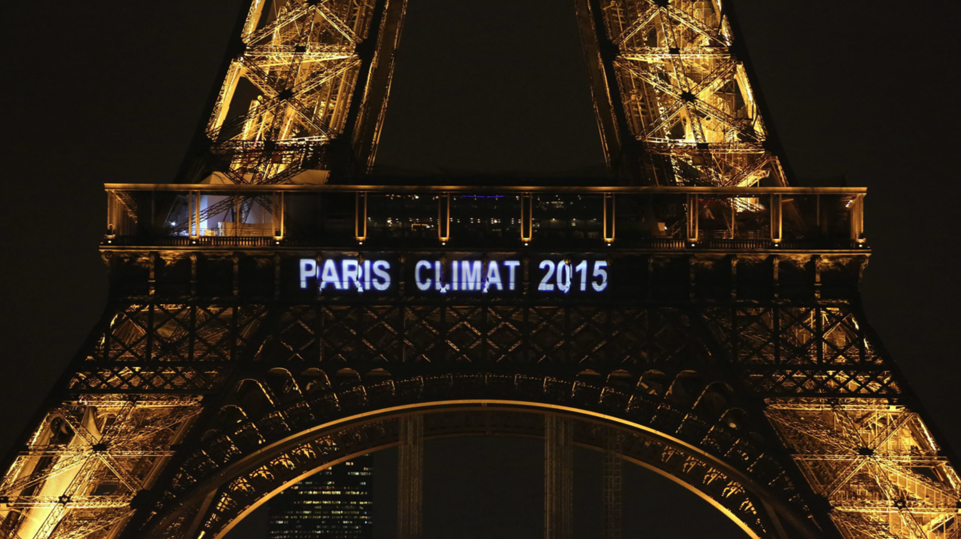
The Paris Agreement commits to
“zero-carbon in our time”
established an unprecedented
international agenda…

Slide 8
The Paris Agreement commits to
“zero-carbon in our time”
… committing us …

Slide 9
i.e. … to take action to:
… hold the increase in global average temperature to
well below 2°C above pre-industrial levels and pursue
efforts to limit the temperature increase to 1.5°C
… to undertake rapid reductions in accordance with best science
… on the basis of equity,

Slide 10
To whom are our commitments made?

Slide 11
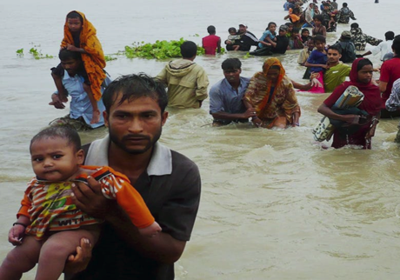

To whom are our commitments made?
The poor in climate-vulnerable today
(many families of Manchester’s diaspora)
To our own children tomorrow

Slide 12
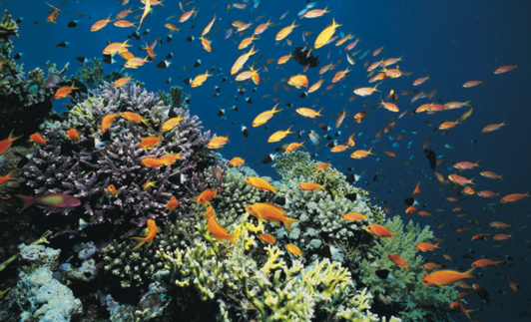

To whom are our commitments made?
To other species & ecosystems
To our own unique home
Notes:
SUM TEAR KA

Slide 13
How should we respond to this challenge?

Slide 14
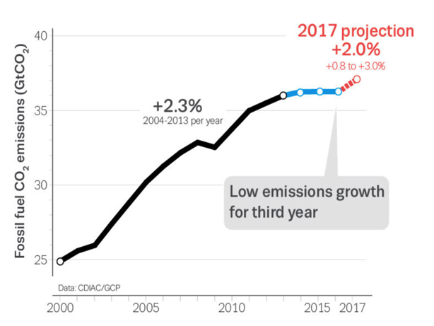
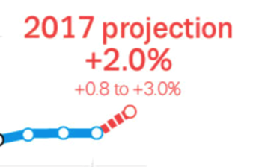

Humility as a starting point for hope & action
1.5%
1990: first IPCC report
2016: CO₂ 60% >1990
2017: CO₂ still rising
Up by around 1.6%
Despite optimistic rhetoric, we’ve not delivered reductions at a global level over the last 28 years…
Notes:
Global carbon project estimates 2018 emissions will go up 2.7%

Slide 15
Thus far … range of technocratic ‘fixes’
  Offsetting … paying others (often poorer people) to diet for us
  Clean development mechanism (CDM) … state backed offsetting
  Emissions trading (EUETS) ... so many permits the €tCO2 stays low
  Afforestation ... plant a tree, maintain or even increase your emissions...
  As yet uncertain ‘negative emission technologies’ (NETs) ... at a planetary scale
  Geo-engineering ... Experimental and uncertain particularly at scale
  … distracting from significantly cutting our CO₂?

Slide 16
Where should we go from here…?

Slide 17
Take home issues to inform action
  The Paris commitments are far more challenging than most
  scientists & politicians are prepared to admit
  Long term targets don’t appropriately connect science and our global commitments (e.g. 2030, 50, etc.)
  It’s total emissions - Carbon Budgets - that matter
  Real mitigation is still possible for 2°C – but only just…

Slide 18
What does science tell us about limiting warming to 2°C?

Slide 19


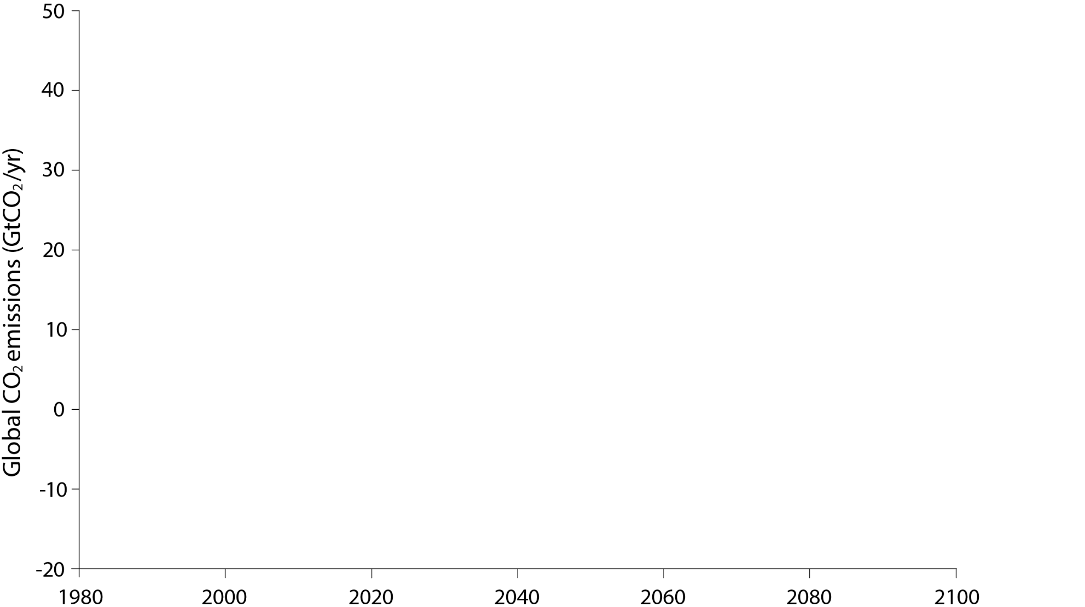

X
4°C to 6°C
3°C to 4°C
2018
740GtCO₂
~1600GtCO₂
1980
2000
2020
2040
2060
2080
2100

Slide 20
… alternatively
… it’s all about pies …

Slide 21
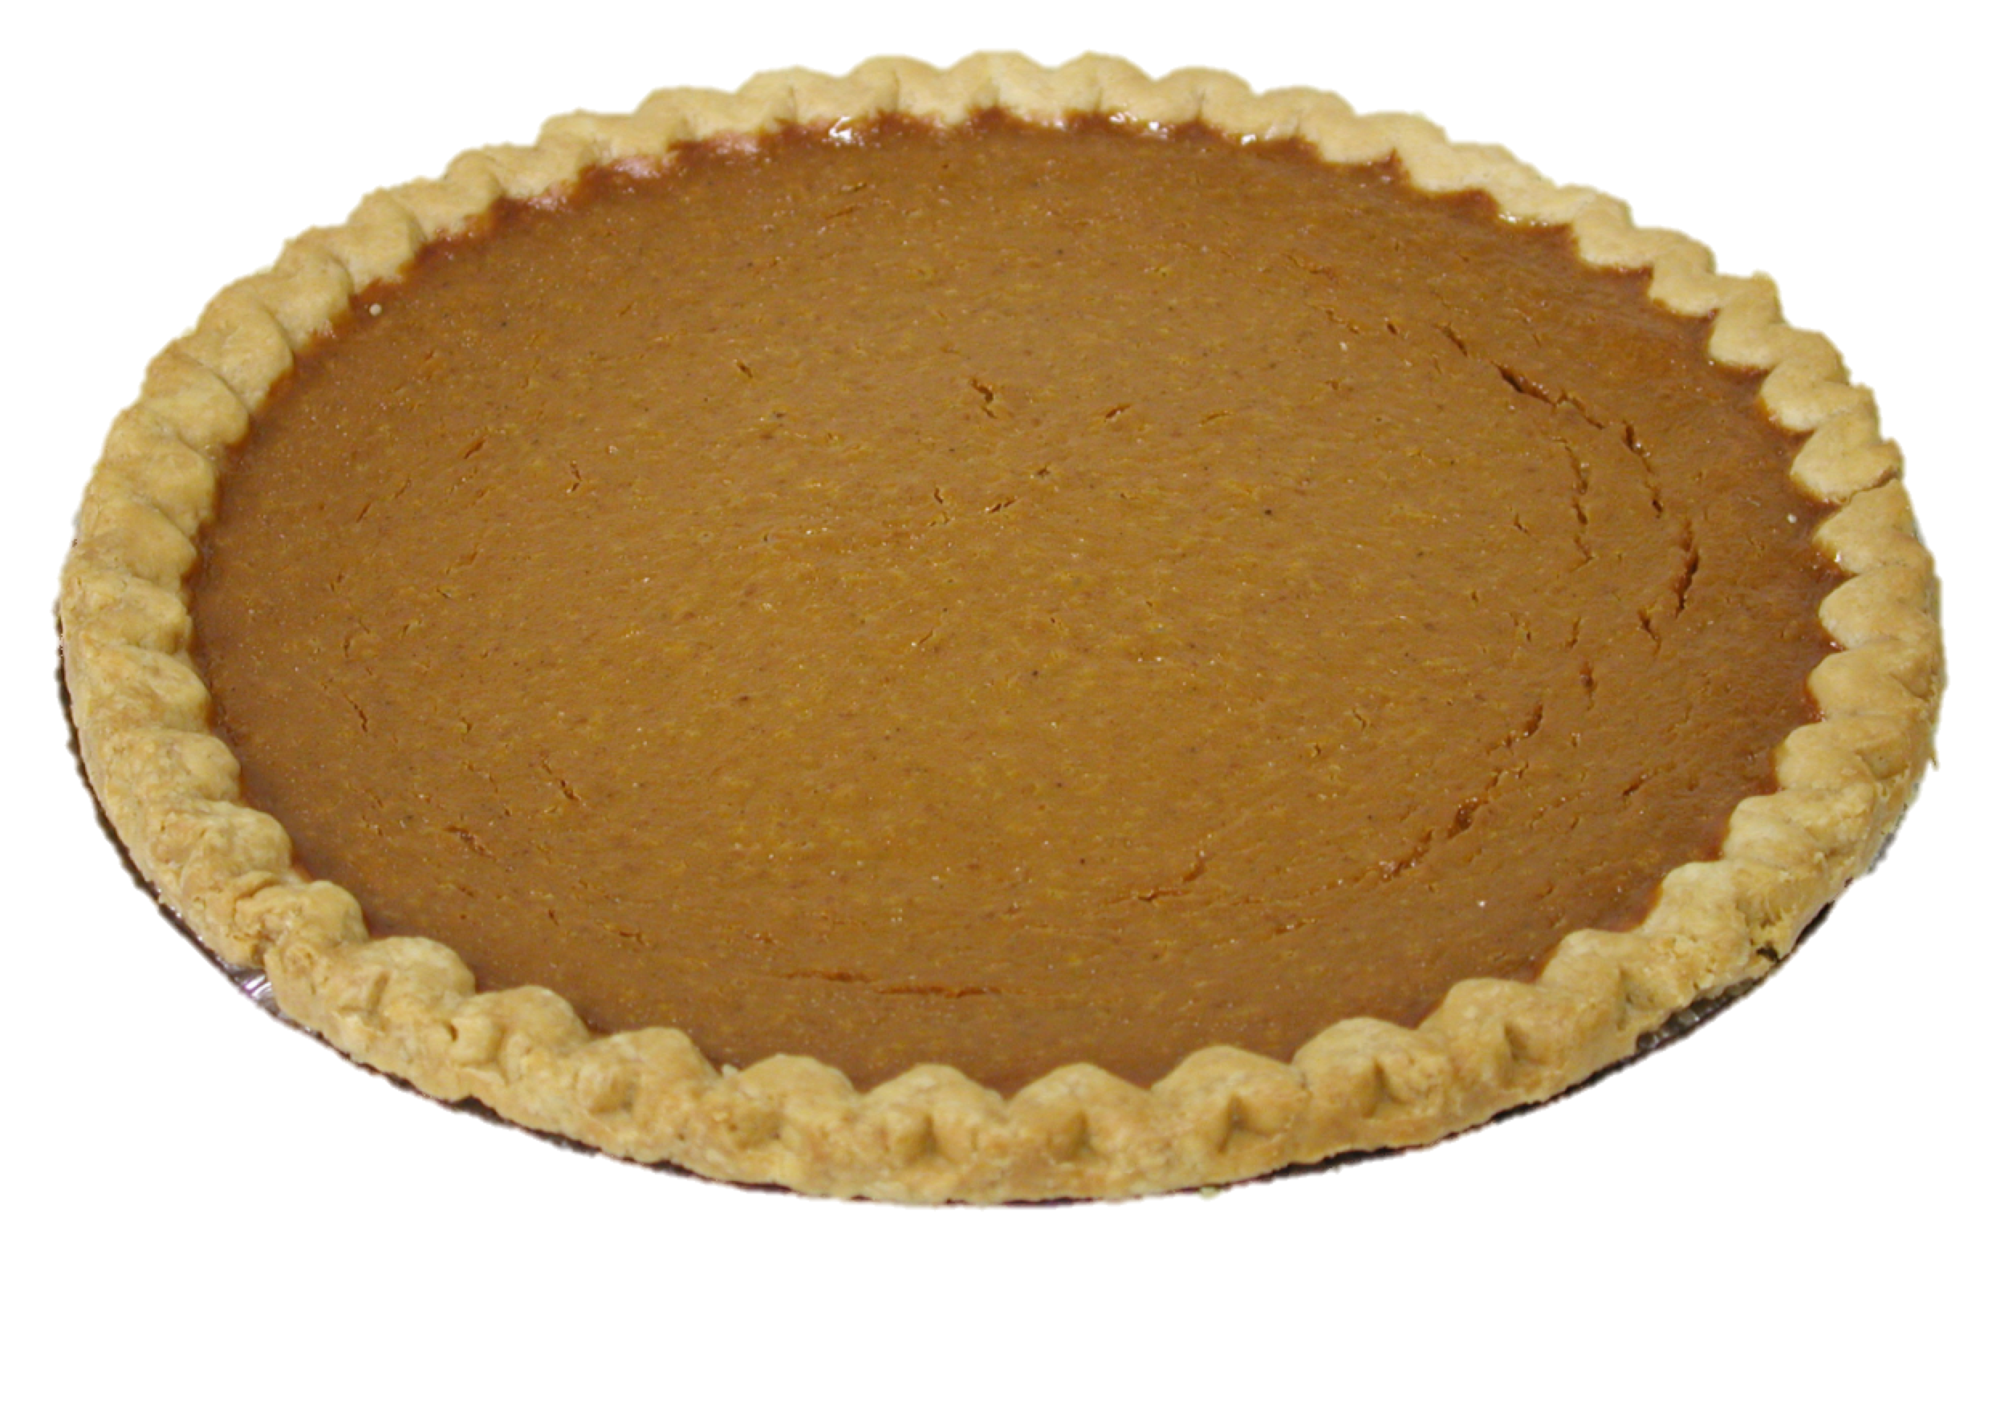
So to limit warming to a 2°C rise …
we have a set
global carbon pie
i.e. total CO₂ that can be emitted from now to forever …

Slide 22
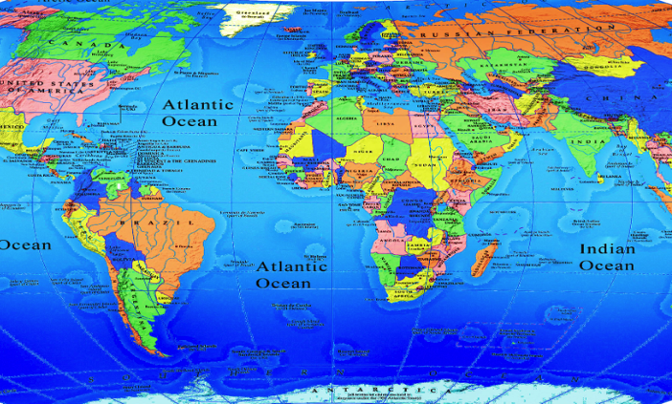
So to limit warming to a 2°C rise …
… this needs to be split
equitably amongst
all of the world’s nations

Slide 23



What is a fair slice for the UK?

Slide 24

Of the UK budget …

Slide 25

… how much should GMCA get?

Slide 26
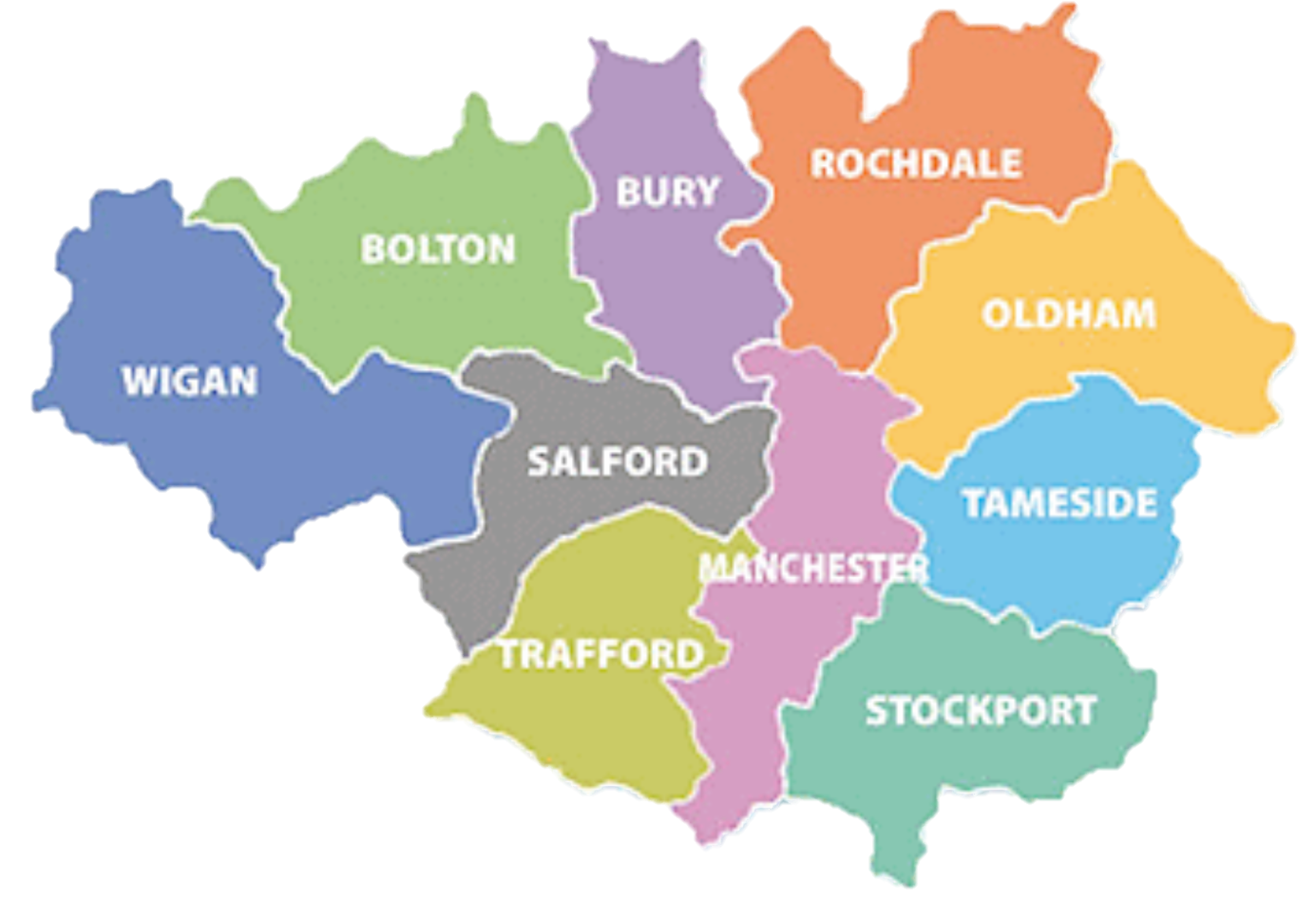
So we have a carbon budget
for GMCA
… for 2018 to 2100 and beyond …

Slide 27
And for those that like numbers (more than pies)
GMCA’s Paris 2°C energy budget is:
71 million tonnes of CO₂ … for 2018 onwards
(range 45-105MtCO₂)
i.e. around 5 to 6 years of current GMCA CO₂ emissions
Need for 10-15% year on year reductions
‘Carbon neutrality’ before 2040

Slide 28
Action in Greater Manchester
Mayoral commitment to Tyndall budgets
Manchester City Council adopted the budgets
Springboard plan (17 actions for the 12 months following the summit)
  Smart energy plan (infrastructure plan – digital, G&B, EVs)
  Net zero carbon buildings
  Retrofitting assessment
  Environment and innovation funds – combining public and private sources?
  Manchester plastic free
  Plans for emission free bus fleet
More details at https://www.greatermanchester-ca.gov.uk/media/1317/springboard-report.pdf

Slide 29
How can we support change?
Immediate – deep and rapid change in behaviours and practices
  Top 10% emitters responsible for 50% global emissions
  If reduced emissions to EU mean – 1/3 cut in global CO₂.
  Institutions and individuals with authority can influence and lead by example to catalyse wider system change – ‘zones of influence’
2. Significant shift in infrastructure and processes
  Retrofit buildings and new developments– narrow the acceptable envelope
  Travel, fleet and car parking policies
  Procurement and service contracts (from energy to appliances)
  A test bed for low carbon technologies and policies
  Scale up success
  Every decision has to deliver for sustainability (not an add on or nice to have)
3. Lobby for and support change at a local, national and international level
  Demonstrating our commitment– supporting others.
  Asking for more from our suppliers, from government, working with others in the sector
  Telling our success stories and sharing our learning

Slide 30
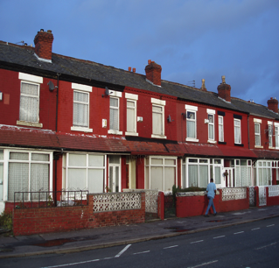
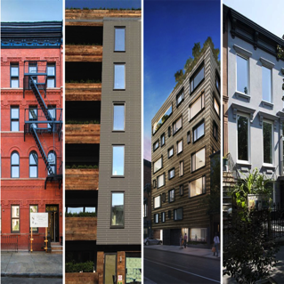


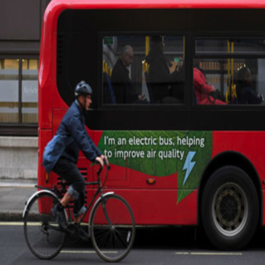
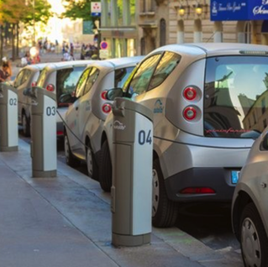
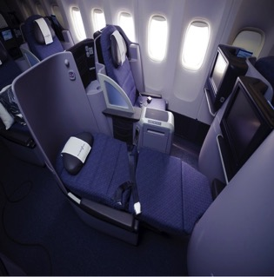
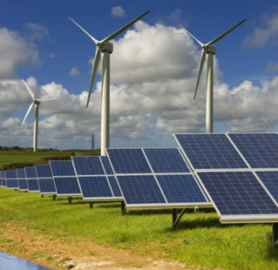
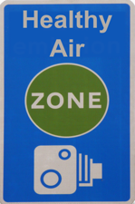
Examples of actions for 2°C
Virtual
communication
Retrofit
Passive house
Reduced flying
`
No
first/business
Charging
(inc. bike)
Zero-CO₂
energy

Slide 31
Benefits of action
Cost savings… energy and equipment lifetime costs (might have to shift finance ‘windows’ of analysis)
Authentic leadership – connecting with values
Many benefits that cannot be easily measured – so we must be careful of simple cost benefit analyses
  Active travel
  Green space
  Air quality
  Healthier homes
  Skills and employment
  Retaining value of energy consumption locally – investment
  Community, inclusion, loneliness

Slide 32
Thanks for listening
@carlymclachlan
c.mclachlan@manchester.ac.uk
www.tyndall.ac.uk

