Slide 1
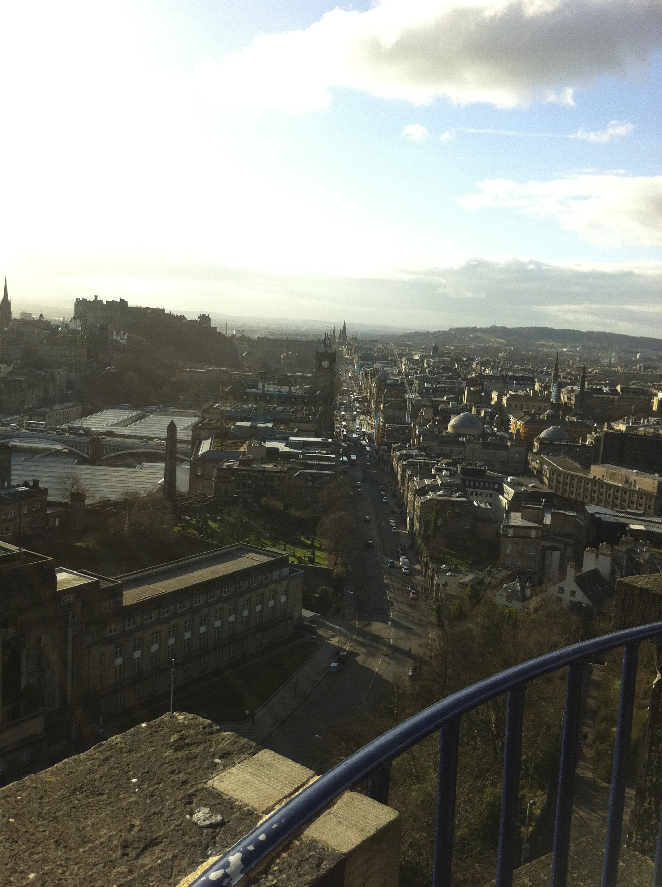
The physical and social impact of traffic-related air pollution on the health of Scottish residents
Dr Jackie Hyland
MBChB, MD, MFPHM, MBA

Slide 2
Exposure Dynamics
Source
substance
origin - e.g. traffic
Pathway
dispersion
weather
barriers
Human Receptor
exposure
behaviour
vulnerability

Slide 3
Scottish air pollution trends for all regulated emissions, 1990 (baseline) to 2014 Bailey et al., 2016, p13

Slide 4
Forest plot showing the HR results for all cause mortality from exposure to elevated levels of traffic-related NOx/NO₂ emissions

Slide 5
Forest Plot showing meta analysis for HR for respiratory/lung disease from NOx/NO₂ exposure

Slide 6
Number of papers reporting each health-related outcome

Slide 7
A conceptual model of the main determinants of health (Whitehead et al., 2001, p314)

Slide 8
Confounding factors considered in the cohort studies

Slide 9
Scottish (Air Quality) Needs Assessment Study (McAllister and Hyland, 2014)
Less than 1% of Scottish residents live in AQMAs
Most are aged between 29-40 years (75%)
Men (54%)
19% of AQMA residents are in the most deprived quintile.
Mortality and hospitalization rates were lower in AQMA residents
Reducing air pollution
by 13µgm³ = reduction AQMA attributable deaths 73 pa
by 1µgm³ =reduction non-AQMAs 153 attributable deaths.
AQMA attributable hospitalisations = 1,961;
non-AQMA attributable hospitalisations = 27,517.

Slide 10
Record of air pollution levels recorded at air quality monitoring sites in Edinburgh and Glasgow, 20-28th March 2012

Slide 11
NHS 24 calls for air pollution related symptoms one week, during (20/03-28/03/12) and one week after high levels of air pollution recorded in Glasgow and Edinburgh

Slide 12
Dundee Ward Areas

Slide 13
Coronary Heart Disease Admissions, by Dundee Ward, both sexes, all ages, 2002-2005

Slide 14
Air Pollution - Perceived barriers to change

Slide 15
Air Pollution - Perceived incentives for change

Slide 16
Key themes to encourage behaviour change

Slide 17
Main mode of travel - large urban, remote rural and Scotland, 2009/2010. (Transport Scotland, 2017)

Slide 18
Type approval (left) and real-world emissions (right) from diesel light duty vehicles across Euro standards. (European Commission, 2013, p22).

Slide 19
Estimated premature deaths from urban air pollution exposure, Europe and Scotland

Slide 20
Estimated loss of productivity due to air pollution related illness, Europe and Scotland

Slide 21
Risk of physical inactivity compared to road accidents, deaths UK, 2008 (Cavill, 2013)

Slide 22
The cost comparison for active travel interventions in Scotland, based on YLL and cost per QALY

Slide 23
Cost benefit analysis of LEZ in Scotland – annual estimated value

Slide 24
Chapter 1 describes what is known about traffic-related air pollution and current regulatory and policy directives to reduce pollution
What are the health effects - type and quantity?
Chapter 2 presents the findings from a rapid assessment of the evidence through a review of the literature on the health impact of traffic-related air pollution in Scottish residents living near busy roads
Is the evidence sufficient to demonstrate causality?
Chapter 3 reports on an assessment of the strength of evidence that traffic-related air pollution causes ill health
How many people in Scotland are being affected?
Chapter 4 demonstrates how the application of national guidance has been used to estimate the impact of traffic-related air pollution the health of residents in Air Quality Management Areas.
Why has it been difficult to achieve further reductions in traffic related air pollution?
Chapter 5 explores the perception of barriers and incentives for change amongst key agencies involved in air pollution management.
How can policy achieve change?
Chapter 6 describes a critique of the latest Scottish policy to reduce traffic related air pollution and support behavior change.
Will the cost of policy implementation paradoxically lead to ill health?
Chapter 7 considers the cost and benefits of a low emission zone proposal and the willingness to pay for improved health.
Does air pollution have a physical and social impact on the health of Scottish residents?
Chapter 8 summarises the findings and presents conclusions and recommendations for further research.
Traffic related air pollution harms health.

Slide 25
Conclusions
The evidence suggests there is little impact on population health from traffic-related air pollution at current emission levels.
There may be health effects for vulnerable individuals but this is difficult to prove.
The wider socioeconomic benefits of improving air quality in Scotland must be considered in policy development and implementation.
It is unlikely that the Clean Air For Scotland Strategy will deliver improved air quality and health without substantial investment, better alignment of planning and a greater public engagement to support public and active transport options.
This is the first time a health and socioeconomic approach to traffic-related air pollution from problem to policy has been documented for Scotland.

Slide 26
Research Recommendations
Source reduction
Improve emissions from vehicles
Review urban planning.
Pathway
Investigate how behaviour of individuals leads to increased exposure
Health
Improve understanding of vulnerability
Policy development
Assess the costs, opportunity costs and benefits by sector (business, health, society) taking into account changing background levels, new technology and policy implementation over time.

Slide 27
Acknowledgements
Professor Peter Donnelly
Dr Jo Inchley
Professor David Harrison
Dr Damien Williams
Dr Paul Reynolds
Dr Emma Fletcher
Dr David McAllister
Mr John
Dr Malcolm
Members of Scottish Transport Emissions Partnership (STEP
Dr Colin Ramsay
Dr Drew Walker
Mrs Lesley Marley

