Slide 1
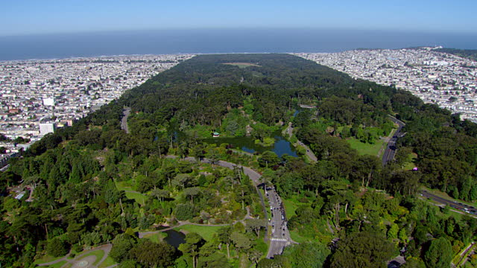
Natural environments and health and wellbeing: Evidence and connections with local/national/international
health and environmental policy
SMaSH Seminar
December 2018
Ben Wheeler, Senior Lecturer

Slide 2
Outline
Pathways from nature → health and wellbeing
Some recent evidence
  Green space & Blue space
  Links with health inequalities
What’s it worth? Valuing nature for health
Linking evidence, policy and practice

Slide 3
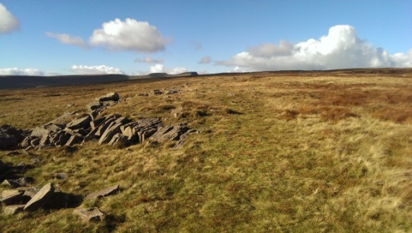
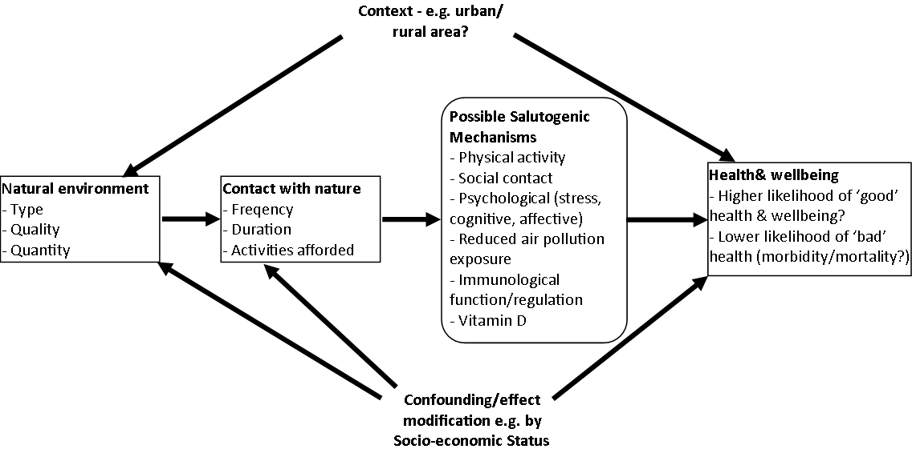
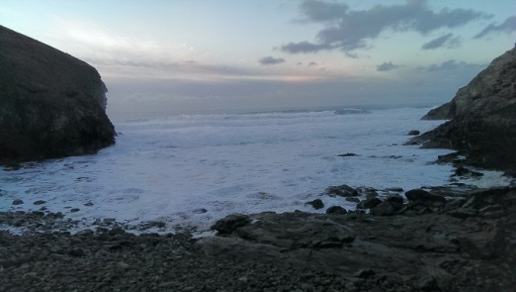
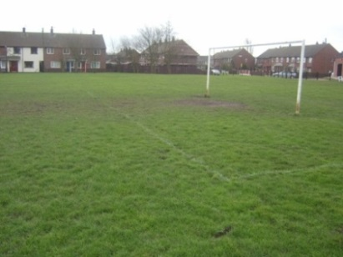
Nature – Health & Wellbeing Pathways
Wheeler et al 2015. Beyond greenspace: an ecological study of population general health and indicators of natural environment type and quality. Int J Health Geogr 14, 17. Adapted from Hartig et al 2014 Nature & Health. Ann Rev PH

Slide 4
Nature – Health & Wellbeing Pathways
Societal Structures
Cultural Norms
Nature Connectedness
Individual Agency
Wheeler et al 2015. Beyond greenspace: an ecological study of population general health and indicators of natural environment type and quality. Int J Health Geogr 14, 17. Adapted from Hartig et al 2014 Nature & Health. Ann Rev PH

Slide 5
How do we understand this complexity?
Qualitative interview/ focus groups
Geographic/Proximity Studies
Lab/VR Studies
Visit Surveys
Field Experiments
Systematic review & evidence synth
Geo- narrative

Slide 6
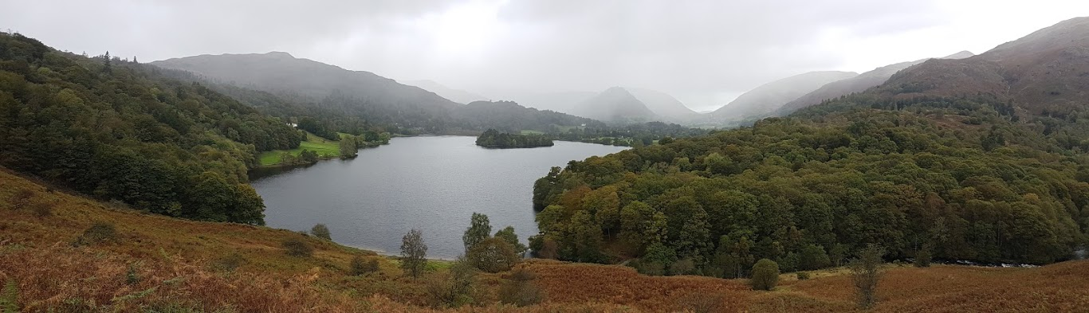
Selected evidence

Slide 7
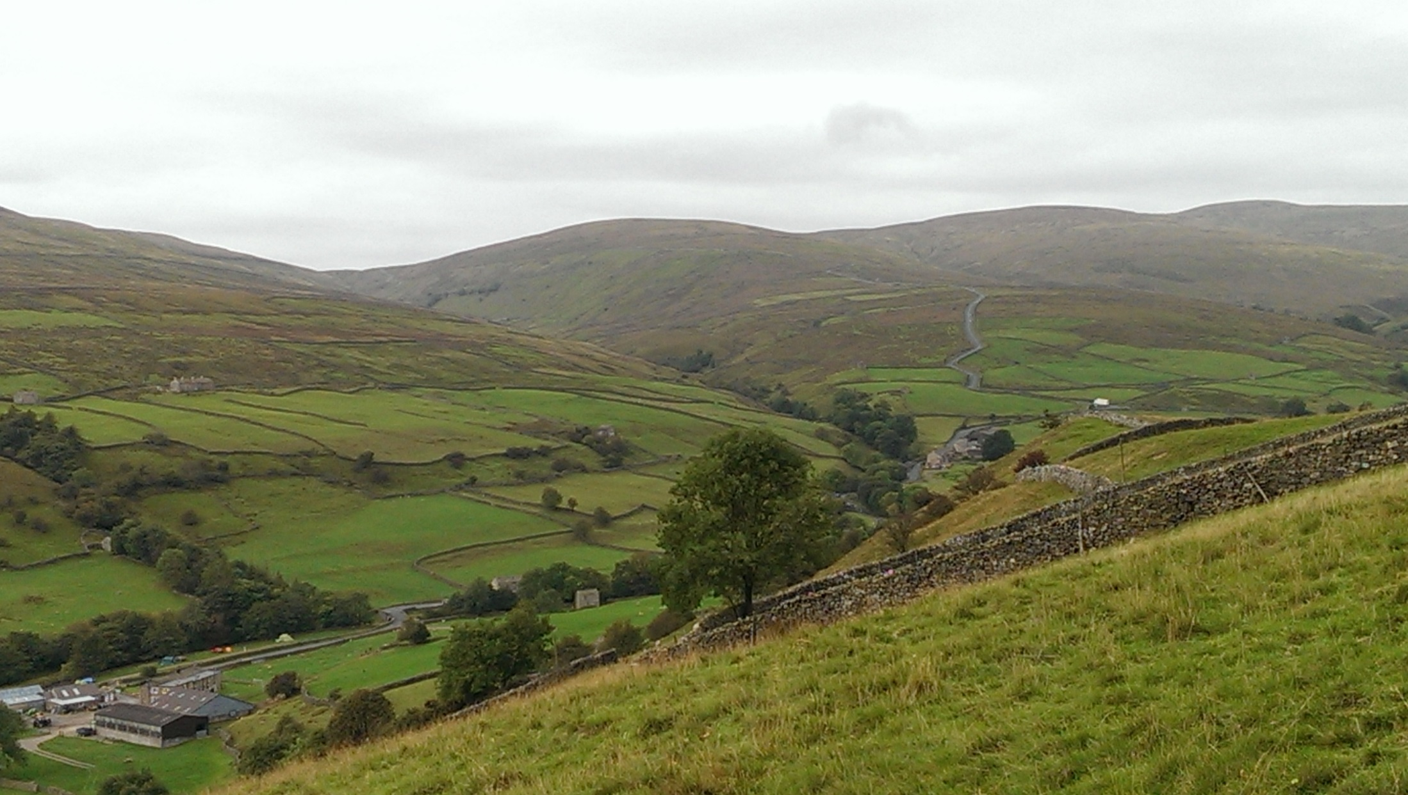
Green space, mental health & wellbeing

Slide 8
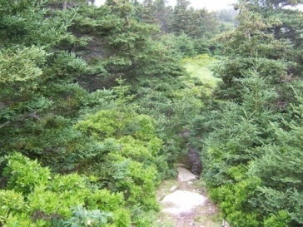

Urban Greenspace & Mental Health in England
British Household Panel Survey (1991-2008)
Each year 5,000 households (n > 10,000) surveyed
Focused on 84% of households in “urban” areas
Mental Ill-health: General Health Questionnaire (GHQ-12) “Compared to
usual how have you been feeling in the last few weeks”
e.g. “able to cope”, “stressed”. The higher the score, the
higher the mental distress.
Subjective well-being: Life Satisfaction (LS): “How dissatisfied or satisfied are you with your life overall?” with responses ranging
from 1 (Not satisfied at all) to 7 (Completely satisfied).
r_{(GHQ/LS)} = -.50

Slide 9
Urban Green space & Mental Health in England
British Household Panel Survey (1991-2008)
We know which small area participants live in, and self reported mental health/wellbeing at each wave
Geographically link with environment data
Do people report better mental health in years when they live in greener urban areas?

Slide 10
Do people report better mental health in years when they live in greener urban areas?
YES
Error bars = 95% confidence intervals
Controlling for:
Individual Level - age, income, education, health, employment status, marital status, children, commute, house type, house size. Area Level: Income, Employment, Education, Crime,
White, Alcock, Wheeler & Depledge (2013). Would you be happier living in a greener urban area? Psychological Science.24, 920-928.

Slide 11
BHPS & Mental Health
British Household Panel Survey (1991-2008; 27,284 Urban LSOA)
Modelling the impact of moving from an LSOA 1SD < M Green cover (48%) to one 1SD >M green cover (81%)
  Mental well-being (Inverse GHQ: 1-12)
  (N = 12,818; Obs = 87,573)
  Life Satisfaction (1-7)
  (N = 10,168; Obs = 56,574)
Controlling for:
Individual Level - age, income, education, health, employment status, marital status, children, commute, house type, house size. Area Level: Income, Employment, Education, Crime,
White, Alcock, Wheeler & Depledge (2013). Would you be happier living in a greener urban area? Psychological Science.24, 920-928.
Notes:
The positive effect of this increase in greenspace is similar in effect size to around 1/10 of the positive effect of having a job vs not having a job, or about 1/3 of the positive effect of being married vs being single

Slide 12
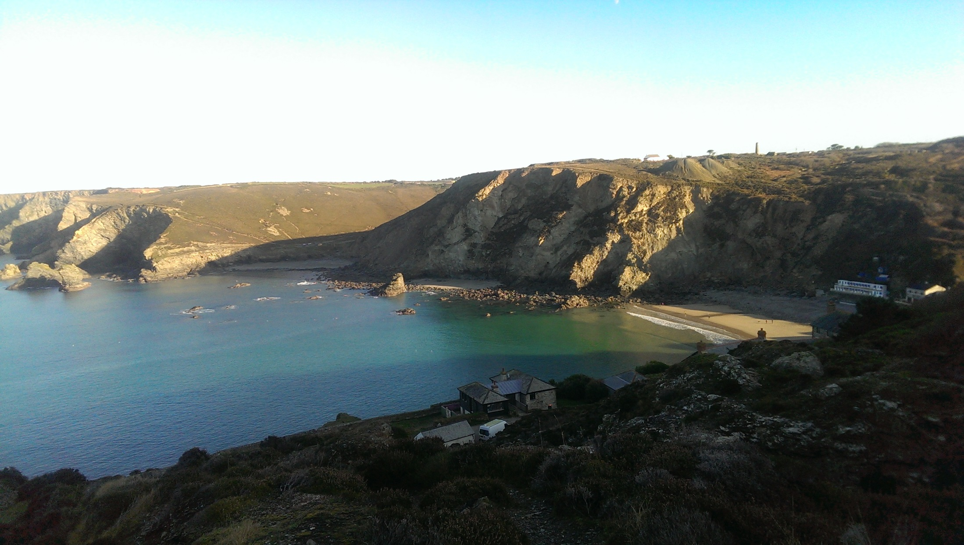
What about ‘blue space’?
Evidence on coastal environments

Slide 13
The coast in Europe
European Coast: ≈ 89,000kmª
It’s a place where people: live ≈ 200 million inhabitantsª
work ≈ 5.5 million jobs^{b}
generate growth ≈ €500 billion pa^{b}
[Mostly urban]
And yet “many people have little understanding of the importance of our seas and oceans in their daily lives [and] the impact they have on human health and wellbeing” (Draft Rome Declaration, 2014)
ªDepledge, M.H., Wheeler, B.W. & White, M.P. (2014). Seas, society, health and well-being. The Marine Biologist, 3, 25-27.
^{b}Blue Growth Strategy: http://ec.europa.eu/maritimeaffairs/policy/blue_growth/;

Slide 14
England’s population health
Census general health question
n ~48m across ~30,000 small areas

Slide 16
Health of coastal populations
Depledge, M., Lovell, R., Wheeler, B., Morrissey, K., White, M., Fleming, L., 2017. Future of the Sea: Health and Wellbeing of Coastal Communities. London: Gov Office for Science
Notes:
Coastal populations of England report poorer health than those inland.

Slide 17
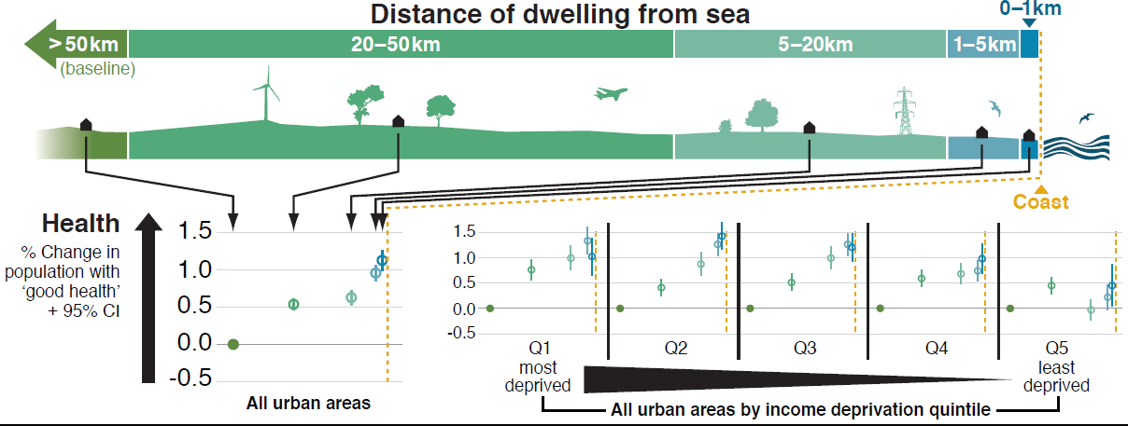

Health at the coast – after adjustment
>50km 20-50km 5-20km 1-5km <1km
Adjusted for population age, sex, Indices of Deprivation, greenspace
Wheeler, B.W., White, M., Stahl-Timmins, W., Depledge, M.H. (2012). Does living by the coast improve health and wellbeing? Health & Place 18 (5): 1198-1201
Notes:
However, coastal populations are actually healthier than expected given that they tend to be more socio-economically deprived and older.

Slide 18
Inequalities
Do good quality environments have the potential to mitigate adverse health impacts of poverty/low socio-economic status?
Equigenic – equality promoting - environments? (Mitchell et al, 2015)
Mitchell, R.J., Richardson, E.A., Shortt, N.K., Pearce, J.R., 2015. Neighborhood Environments and Socioeconomic Inequalities in Mental Well-Being. American Journal of Preventive Medicine 49, 80-84.

Slide 19
Health at the coast & equigenesis
OLS regression coefficients; all models adjust for age, sex, 5 deprivation domains, and greenspace
We find the strongest link in the poorest urban areas; in wealthier areas there’s almost no evidence of a connection.
Wheeler, B.W., White, M., Stahl-Timmins, W., Depledge, M.H. (2012). Does living by the coast improve health and wellbeing? Health & Place 18 (5): 1198-1201

Slide 20
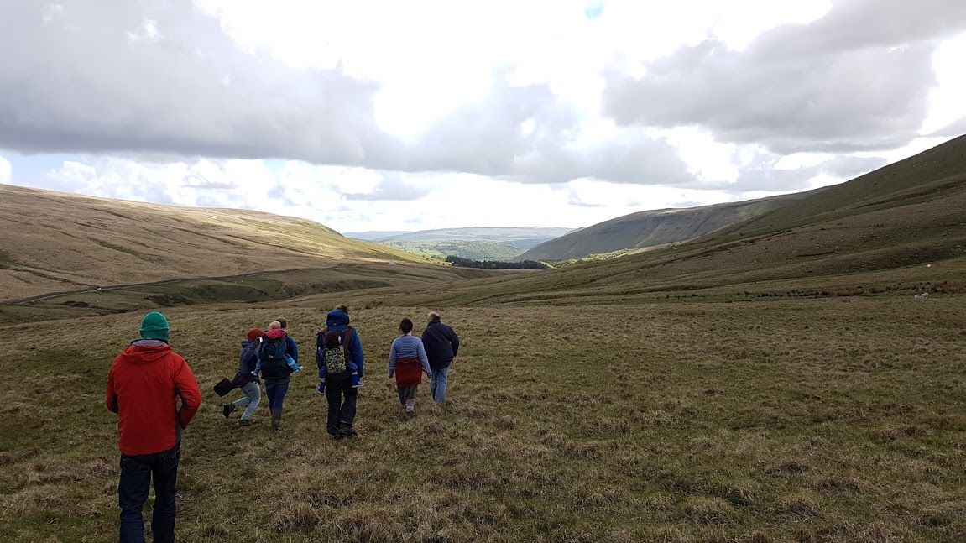
What about actual visits to nature?

Slide 21
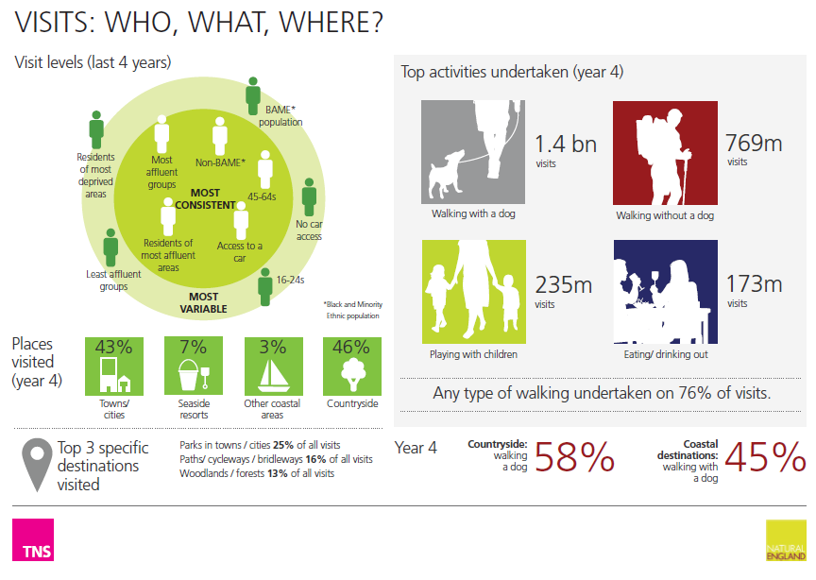
Monitor of Engagement with the Natural Environment
Natural England/TNS (2013) MENE Infographic Report
http://www.naturalengland.org.uk/ourwork/evidence/mene.aspx

Slide 22
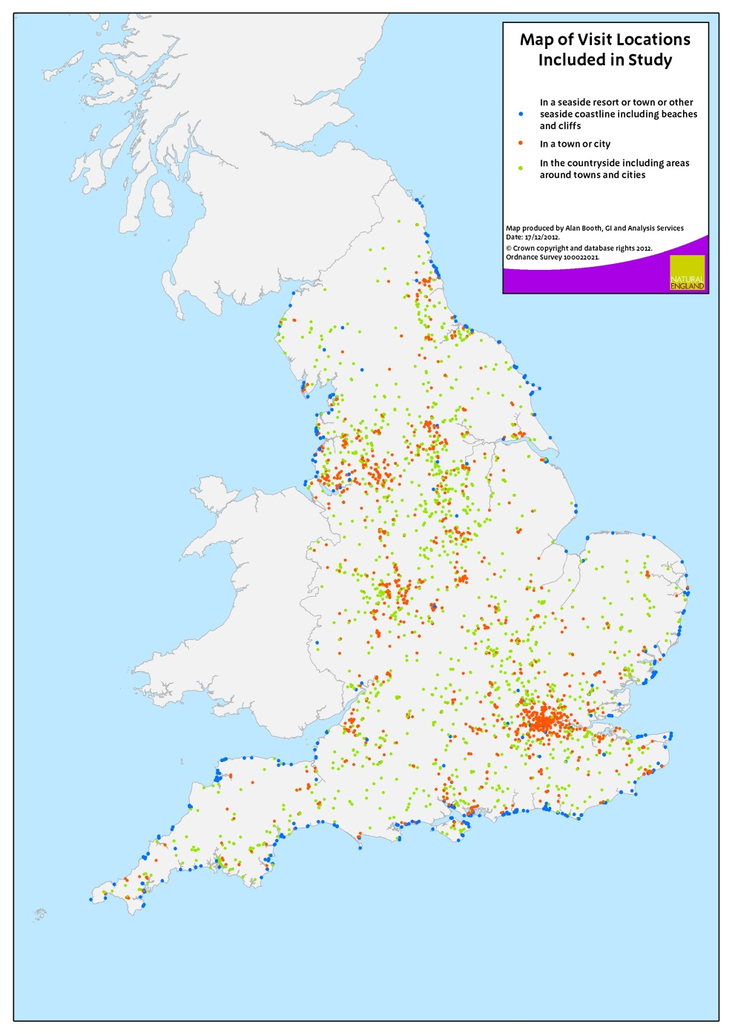
MENE Subset
asked about experiences
Stress reduction: To what extent did they feel ‘x’ after the visit:
1) Relaxed?
2) Calm?
3) Refreshed?
4) Revitalised?
Controlled for Who (Age, gender, SES) & What (activities, duration, who with, distance travelled etc.)
MENE visit locations

Slide 23
Stress reduction in different natural environments
Error bars: 95% CI
White, Pahl, Ashbullby, Herbert & Depledge (2013). Journal of Environmental Psychology, 35, 40-51
Notes:
All visits – report stress reduction, but more in certain environments (woodland, coast and mountains)

Slide 24
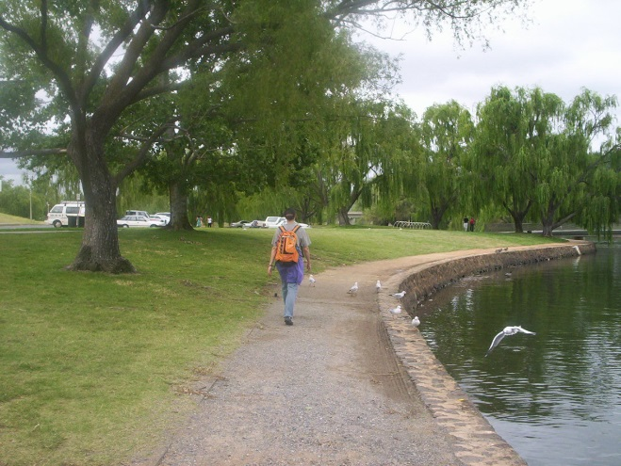
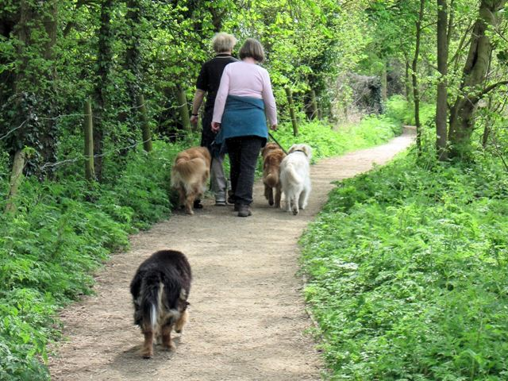
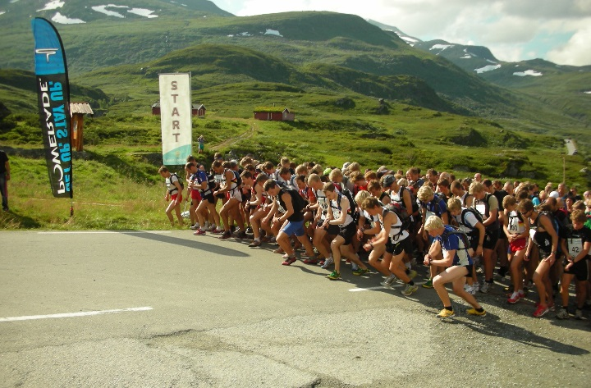
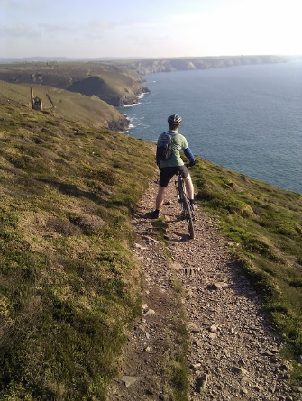
Physical activity
“In the past week, on how many days have you done a total of 30 minutes or more physical activity which was enough to raise your breathing rate? This may include sport, exercise, and brisk walking or cycling for recreation or to get to and from places, but should not include housework or physical activity that may be part of your job”

Slide 25
Do people who live near the coast exercise more?
ref
N = 183,755, controlling for area green space, & deprivation (IMD) + individual age, gender, SES, marital status, employment status, children, ethnicity, disability, car ownership, dog ownership, year and season.
White MP, Wheeler BW, Herbert S, Alcock I, Depledge MH (2014) Coastal proximity and physical activity: Is the coast an under-appreciated public health resource? Preventive Medicine 69:135-140.

Slide 26

What do people do at the coast?
MENE Coastal activities n = 1,290
70%
Most coastal activity doesn’t involve getting wet
Walking is important
17%
3%
2%

Slide 27
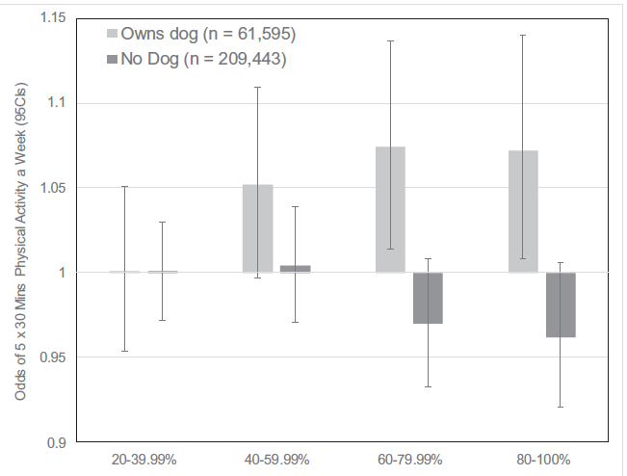
Dog walking & greenspace
Potentially a key effect modifier (in England at least)
We find an association between neighbourhood greenspace and PA – but only for dog owners
White, M.P., Elliott, L.R., Wheeler, B.W., Fleming, L.E., 2018. Neighbourhood greenspace is related to physical activity in England, but only for dog owners. Landscape and Urban Planning 174, 18-23.

Slide 28
Who doesn’t visit nature (including urban)?
Survey data (n~60,000)
a quarter of the population reported visiting natural environments < once a month (‘infrequent’ visitors)
Infrequent visitors more likely to be:
  Female
  Older
  In poor health
  Lower socioeconomic status
  Black & Minority Ethnic Groups
  Live in relatively deprived areas
  Reside in areas with less neighbourhood greenspace
Boyd et al 2018. Who doesn’t visit natural environments for recreation and why: A population representative analysis of spatial, individual and temporal factors among adults in England. Landscape and Urban Planning 175, 102-113.

Slide 29
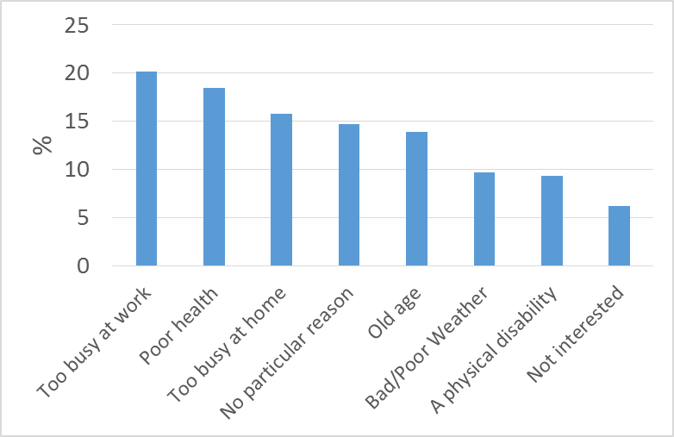
And Why?
Main reason for not visiting nature

Slide 30
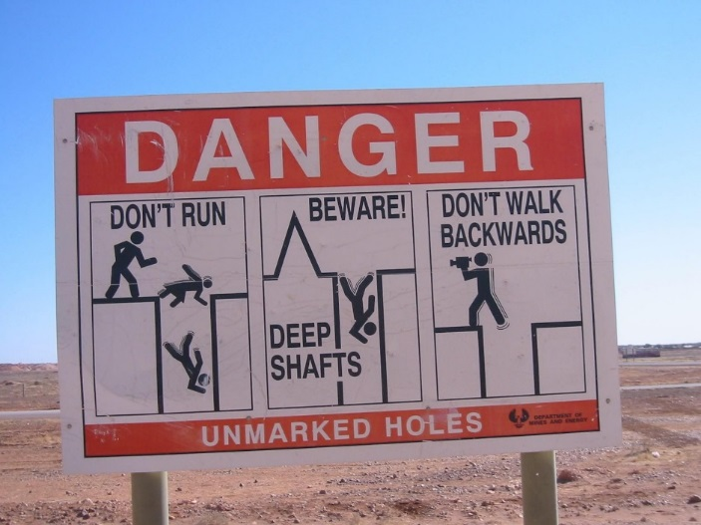
Potential Environmental Risks
Nature won’t be beneficial for everyone – and could be harmful, e.g.
  Pollen – allergies
  Ticks and other disease vectors
  Chemical and biological exposures
  Weather (heat, cold, UV)
  Accidents – injuries, drowning
Context: wider climate change impacts

Slide 31

Risk of increasing inequalities?
Universal public health interventions risk widening inequalities
Risk of gentrification with ‘greening’ of urban areas?
http://www.bcnuej.org/green-inequalities-blog/

Slide 32
Informing policy & practice
Action going on at all levels in environment & health sectors
  Local/city authorities
  National
  International
A lot of enthusiasm
But money talks…

Slide 33
So, what’s it worth?
If natural environments support and promote PA, what’s the health economic value?
PA → better health → £$€¥
?

Slide 34
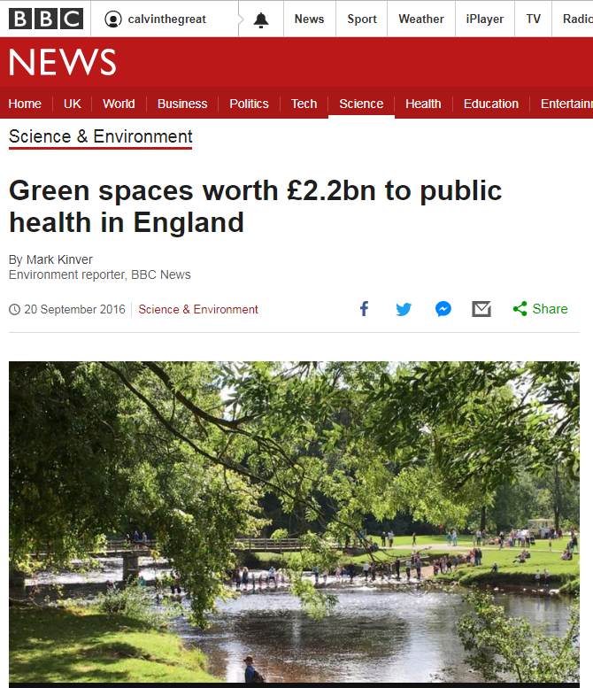
Using MENE data on PA in natural environments and the UK social value of a QALY.
NICE – pay £20k-£30k for a treatment that produces 1 additional QALY
White, M.P., Elliott, L.R., Taylor, T., Wheeler, B.W., Spencer, A., Bone, A., Depledge, M.H., Fleming, L.E., 2016. Recreational physical activity in natural environments and implications for health: A population based cross-sectional study in England. Preventive Medicine 91, 383-388.

Slide 35
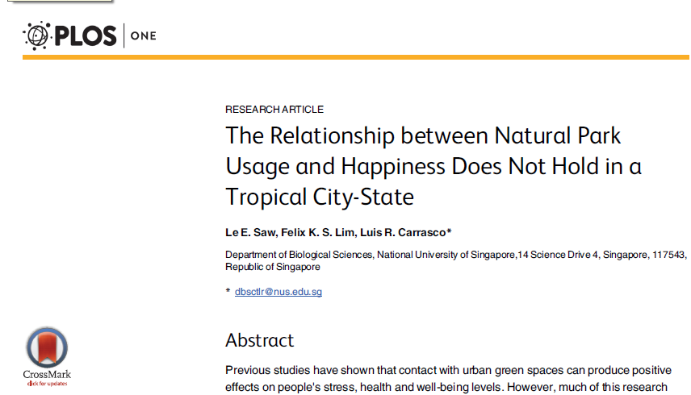
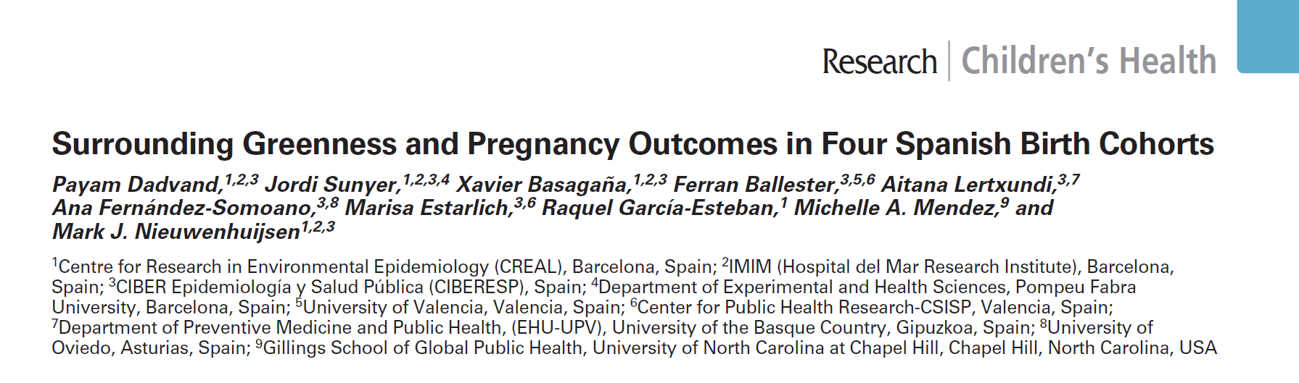
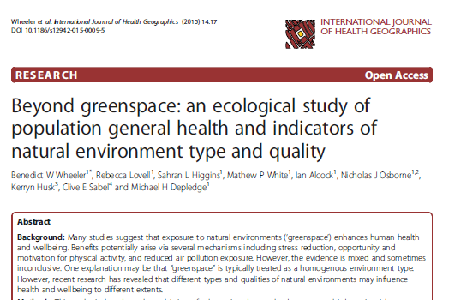
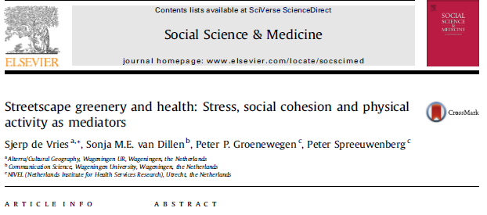
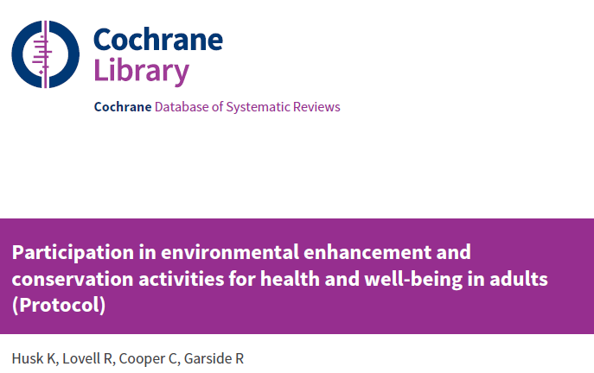
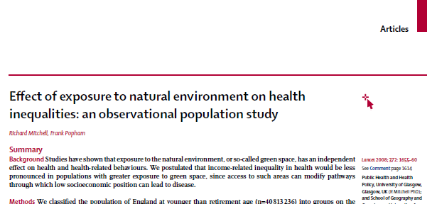
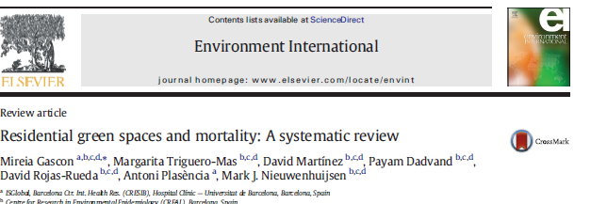
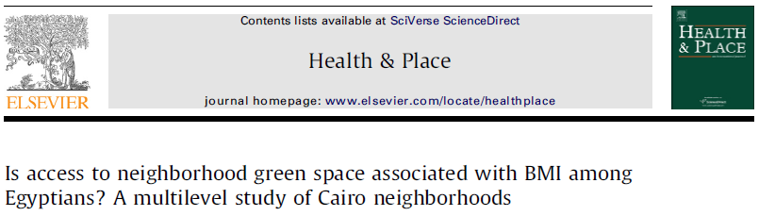
What about all the other evidence?

Slide 36
Recent systematic reviews
Evidence for benefits for a range of health outcomes
But limited e.g. by:
  Lack of causal evidence
  Heterogenity of exposure/outcome measures
  Limited assessment of environmental quality
  Limited control for SES, other covariates
e.g. Gascon et al 2015. Mental health benefits of long-term exposure to residential green and blue spaces: a systematic review. International Journal of Environmental Research and Public Health 12, 4354-4379
Lovell et al 2015 Understanding how environmental enhancement and conservation activities may benefit health and wellbeing: a systematic review. BMC Public Health 15 (1):1-18.
Twohig-Bennett & Jones 2018. The health benefits of the great outdoors: A systematic review and meta-analysis of greenspace exposure and health outcomes. Environmental Research 166, 628-637.

Slide 37
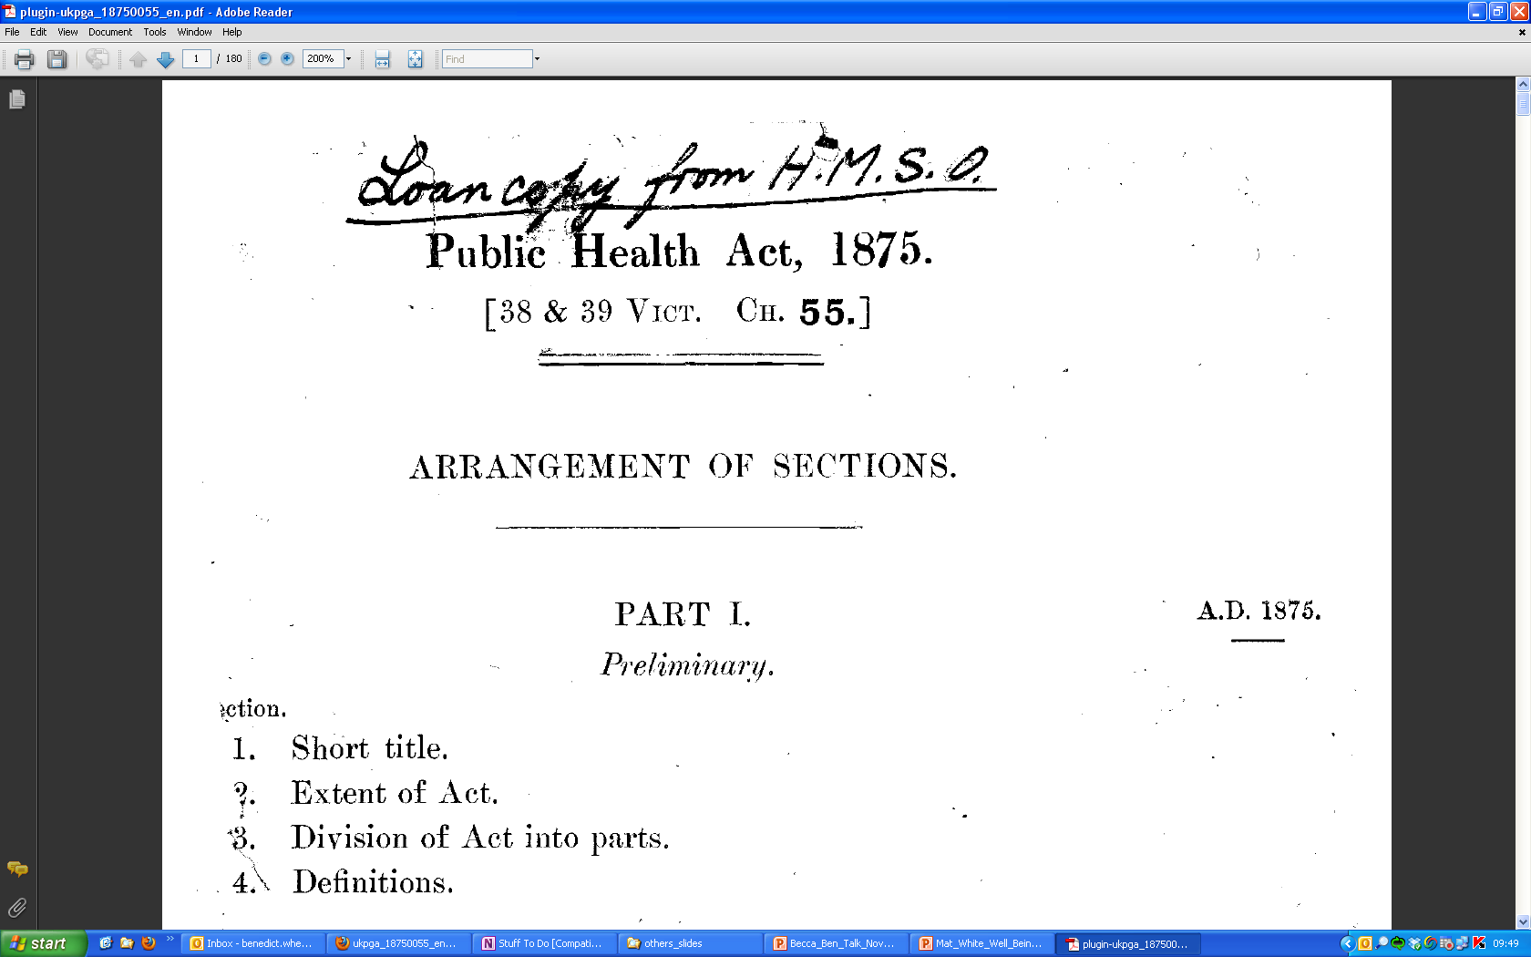
Notes:
This isn’t new…

Slide 38
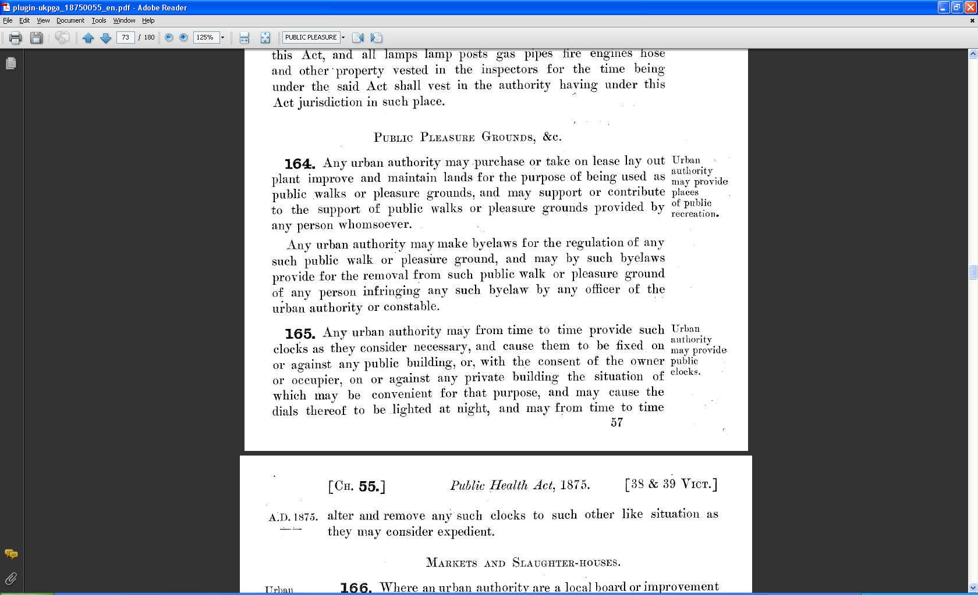

Slide 39
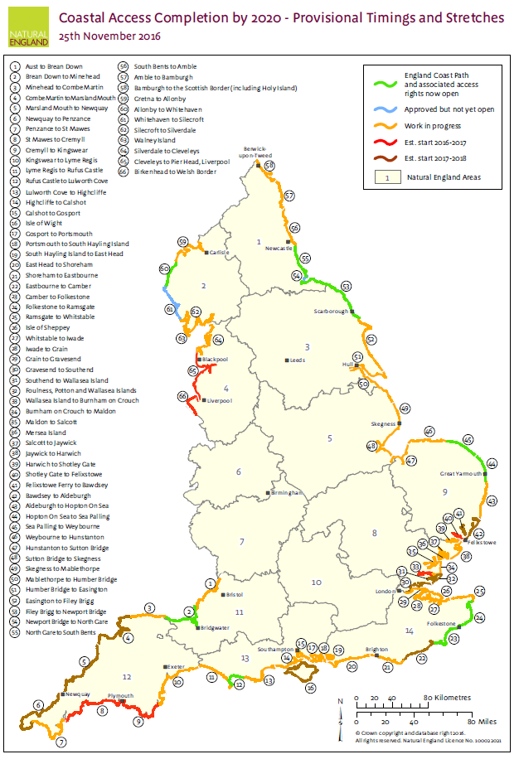
National Policy
Marine & Coastal Access Act 2009
“aims to improve public access to, and enjoyment of, the English coastline by creating clear and consistent public rights along the English coast for open-air recreation on foot.”
http://publications.naturalengland.org.uk/publication/5327964912746496

Slide 40
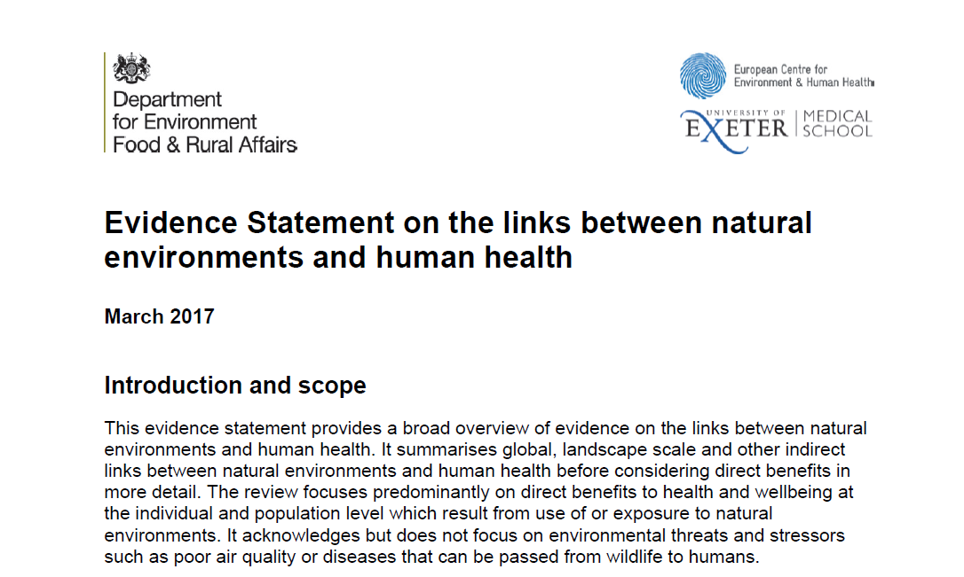
National Policy
Underpins health in the UK government’s 25 year plan for the natural environment
https://beyondgreenspace.net/2018/09/07/defra_health_review/

Slide 41
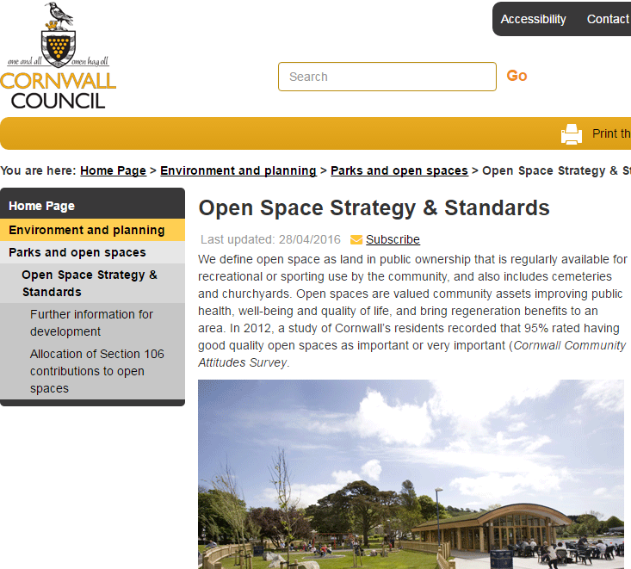
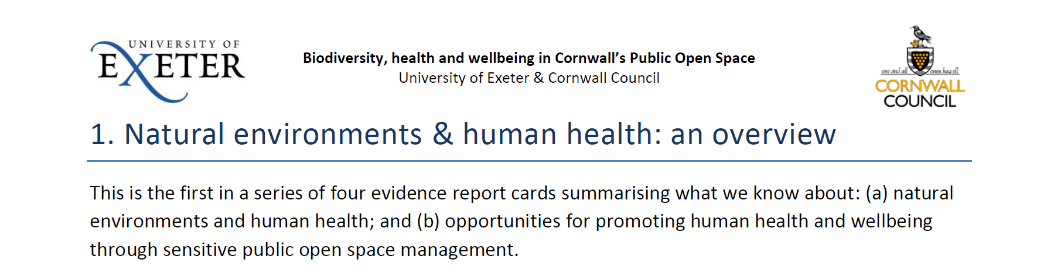
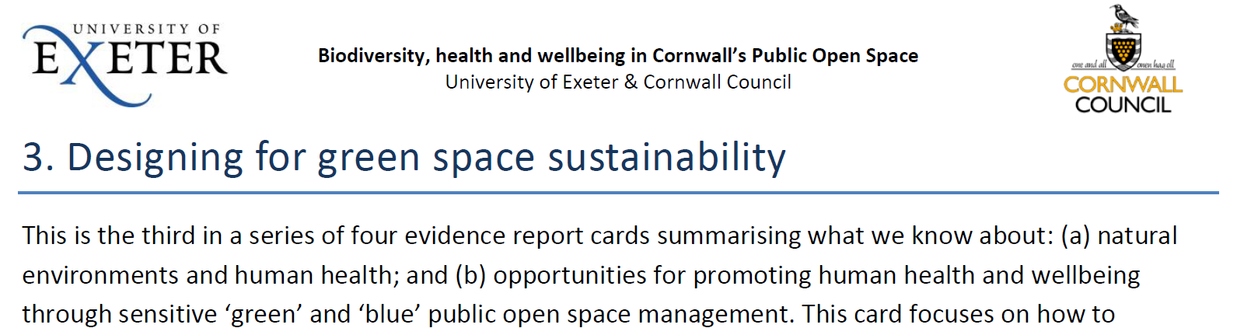

Biodiversity, Health and Wellbeing in Cornwall’s Public Open Space
→Evidence-based management of public open space to support both biodiversity and human health and wellbeing
Supporting Cornwall’s Open Space Strategy
https://beyondgreenspace.net/

Slide 42

Sustainable Development Goals
SDG 11.7
By 2030, provide universal access to safe, inclusive and accessible, green and public spaces, in particular for women and children, older persons and persons with disabilities

Slide 43
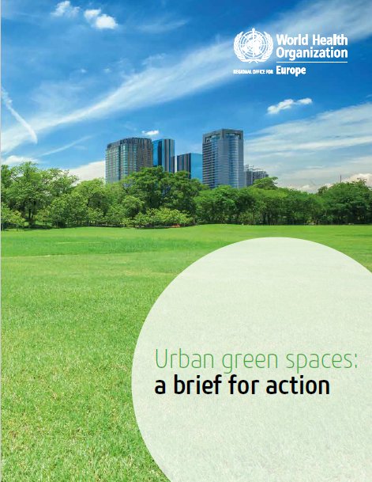
WHO Action Brief

Slide 44


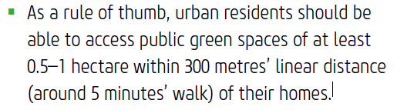
[Amongst a large number of other suggestions]
Why 300m?
  it seems ‘reasonable’ based on the evidence (WHO advisory group)
  Maybe: Grahn & Stigsdotter 2003. Landscape planning and stress. Urban Forestry & Urban Greening
http://www.euro.who.int/en/health-topics/environment-and-health/urban-health/publications/2017/urban-green-spaces-a-brief-for-action-2017

Slide 45


So…
There’s a rapidly growing evidence base
We could be better at considering complexity – of the environment, our interactions with it, mechanisms and health impacts
Increasing accessibility/engagement is not without risk
  Environmental risks
  Negative impacts of gentrification and widening inequalities
But there seems to be potential to act to promote and protect both the natural environment and human health

Slide 46


Thanks to colleagues
Mike Depledge
Lora Fleming
Mat White
Becca Lovell
Sarah Bell
& the rest of the team
b.w.wheeler@exeter.ac.uk
@benedictwheeler
http://beyondgreenspace.net
Beyond Greenspace blog

